Slide 1
Configurable quantum networks
for advanced computing (CoQuNAC)
Irfan Siddiqi
Lawrence Berkeley National Laboratory
Department of Physics, University of California, Berkeley
Hartmut Häffner, Joel Moore, Dan Stamper-Kurn, Umesh Vazirni,
Birgitta Whaley, John Wu
ASCR Workshop: Quantum Computing for Science, February 17-18, 2015

Slide 2
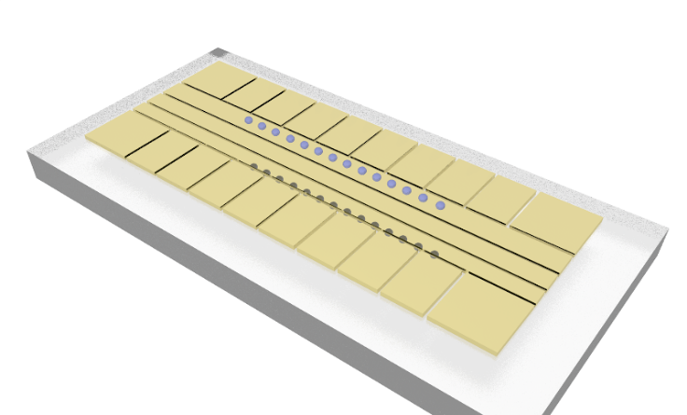
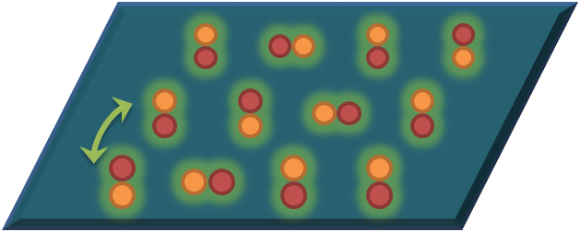
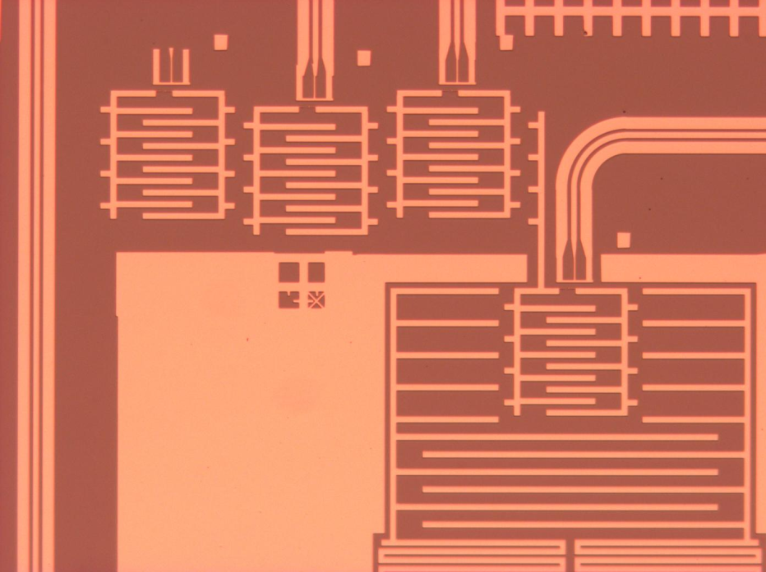
THE HARDWARE…
Cold Atoms
Circuits
Trapped Ions
Lattice Models (solids)
Long coherence
Spin-Boson Models
Access dynamics (closed)
Couple to hybrids
Flexible architecture
Access dynamics (open)
Advanced Measurement

Slide 3
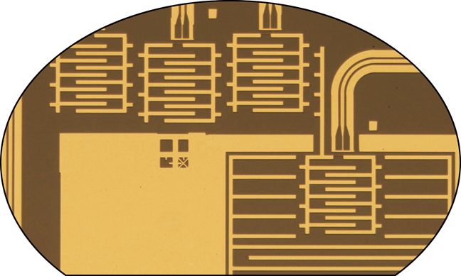
MODELING CORRELATED MATERIALS
Chemical formula
Structural information
Chemical intuition/
Phenomenology
DFT and other
pseudopotential methods
Simplified description
of essentials:
“model Hamiltonian”
Analytical theory
Exact diagonalization
(if model Hamiltonian small)
Emergent properties:
superconductivity,
magnetism, ...
Many-body approximations
(DMRG, DMFT, ...)
a major need/growth area
Notes:
No one other than the condensed matter speakers gets asked #4.

Slide 4
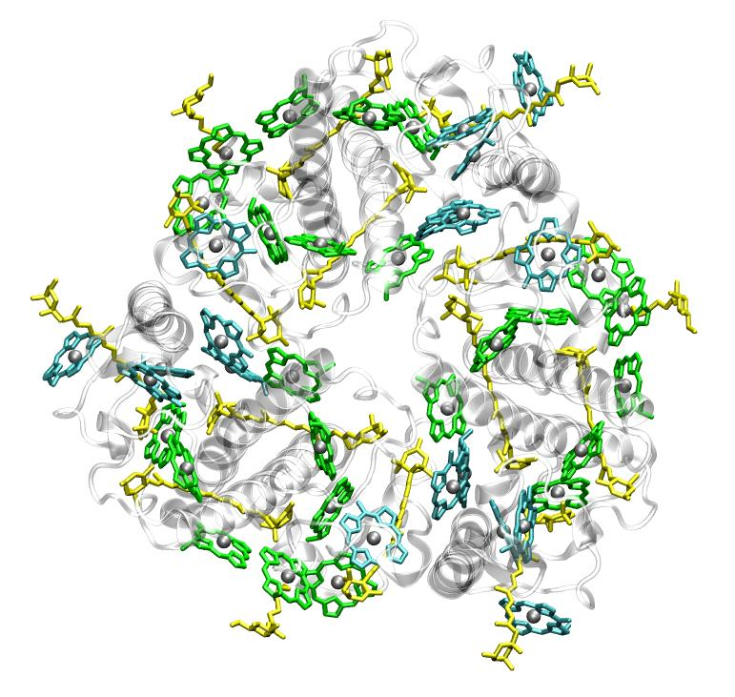
MEASURING CORRELATION FUNCTIONS
Complete knowledge is unnecessary and impractical: storing/measuring all eigenvalues will be impossible. The most important physical quantities are usually “n-point correlation functions”, which are expectation values of n products of local operators.
Example of 1-point correlation function: energy density
Dynamical 2-point correlations: energy transport, conductivity,…
Can we combine a strong-correlation solver with existing computational chemistry to describe <E_{a}(0) E_{b}(t)>, the 2-point dynamical correlation function of energy, describing photosynthetic energy transfer?

Slide 5
THE HAMILTONIAN LANDSCAPE
Quantum Ising,
Bose-Hubbard,
Spin-Boson
Ising-like magnets
Superfluidity
Electron-phonon interactions
Fermi Hubbard
at fractional doping
Photosynthesis
Superconductivity
Spin liquids
Solar water splitting
Development
Time
Synthetic gauge fields,
Relativistic theories
Quantum chromodynamics
QFT?
Gravity?

Slide 6
Notes:
Lumped element LC resonator, rest of the qubit chip.

Slide 7
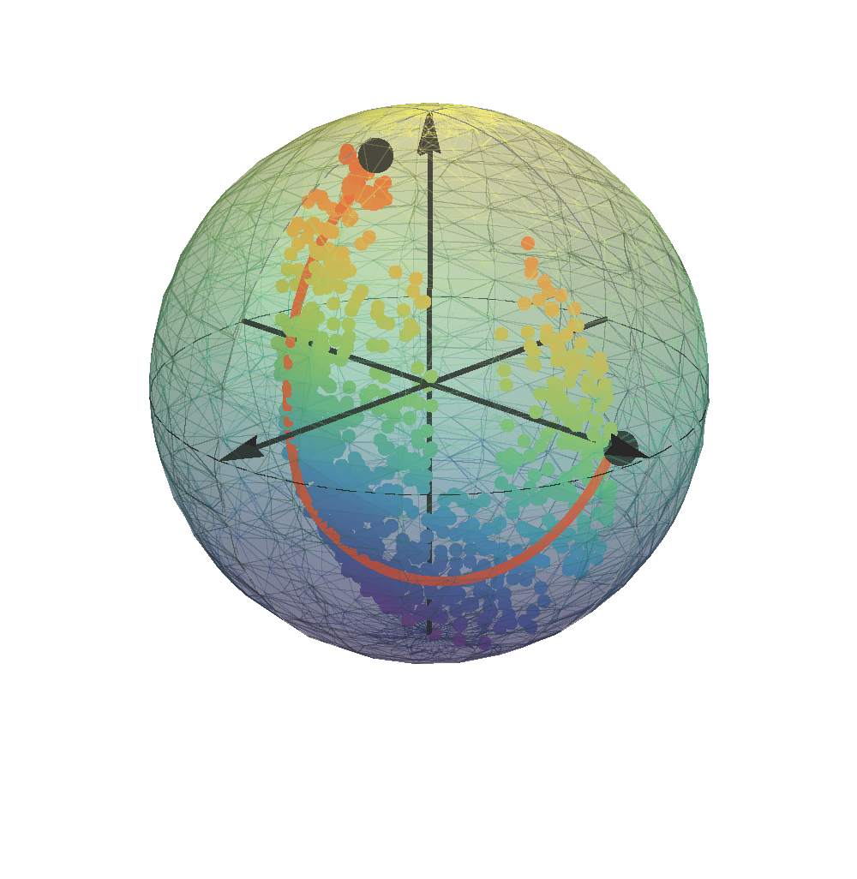
WEAK MEASUREMENTS: REAL-TIME QUANTUM TRACKING
Vary Measurement Strength
Local Measurement Nodes
Extend to Many Qubit Systems

Slide 8
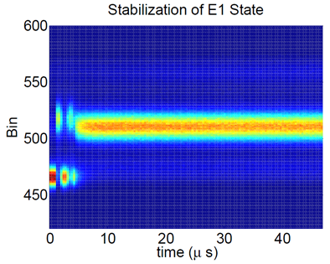
A SUPERCONDUCTING QUBIT TRIMER
Bose-Hubbard Hamiltonian
(interacting bosons on a lattice)
$$|f_{6}〉$$
$$|f_{5}〉$$
$$|f_{4}〉$$
Two-excitation subspace:
States are superpositions of
$$|2,0,0〉, |0,2,0〉, |0,0,2〉$$
$$|1,1,0〉, |1,0,1〉,|0,1,1〉$$
$$|f_{3}〉$$
$$|f_{2}〉$$
Spectroscopy
$$ΔE≈2πℏ×10 GHz$$
$$|f_{1}〉$$
$$|e_{3}〉$$
$$|e_{2}〉$$
One-excitation subspace:
States are superpositions of
$$|1,0,0〉,|0,1,0〉, |0,0,1〉$$
$$|e_{1}〉$$
$$ΔE≈2πℏ×5 GHz$$
$$|g〉$$
Zero-excitation state:
Ground state
$$|0,0,1〉$$

Slide 10
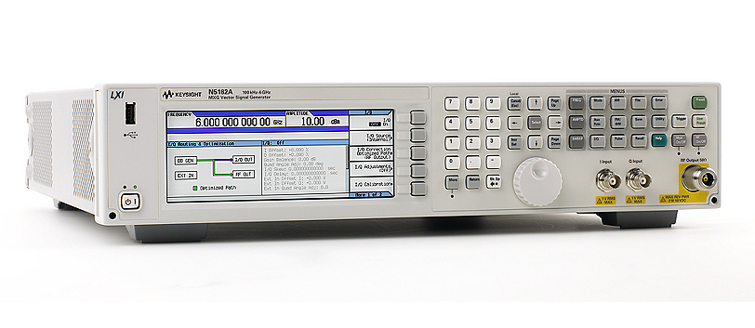
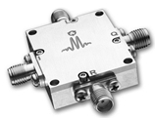
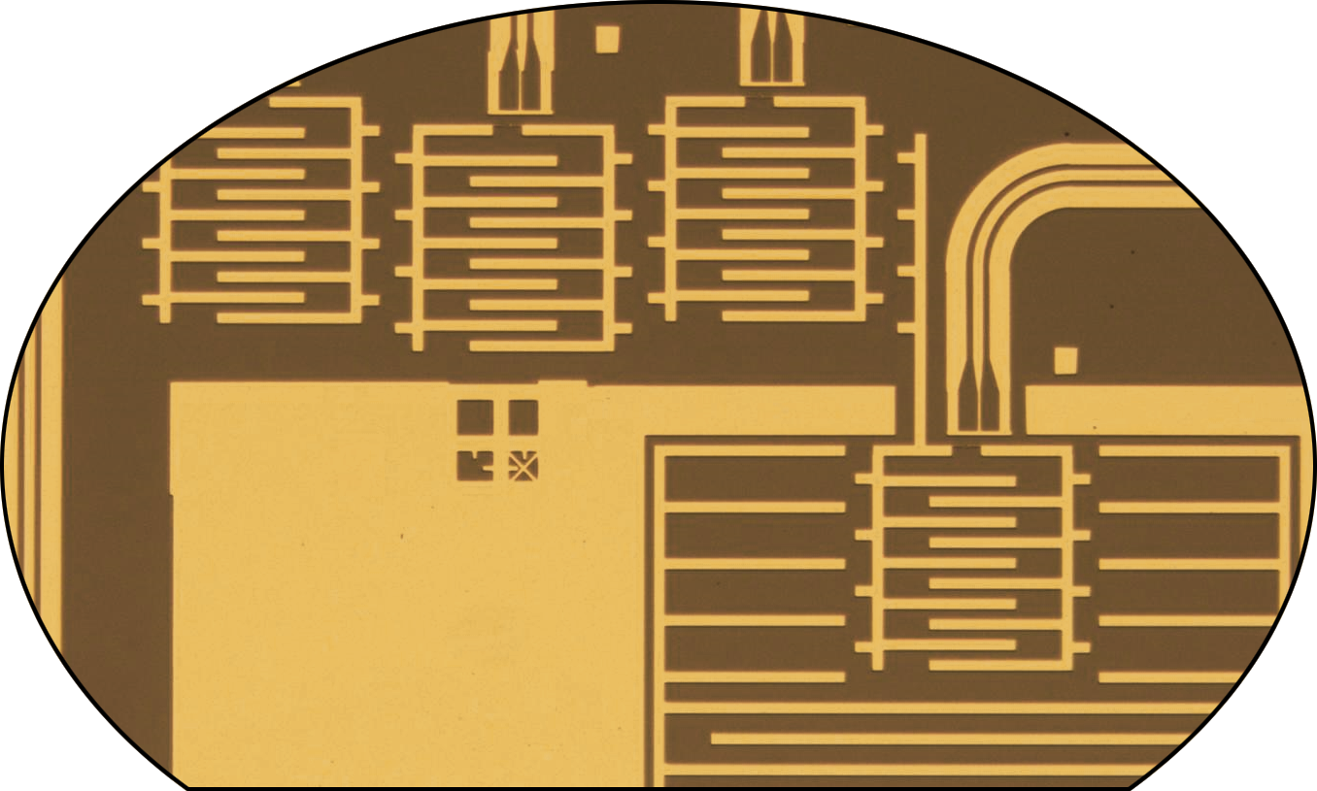
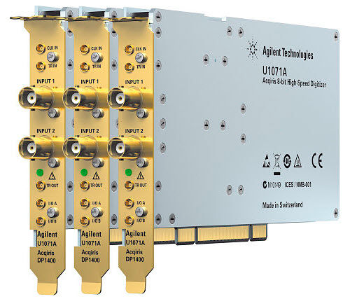
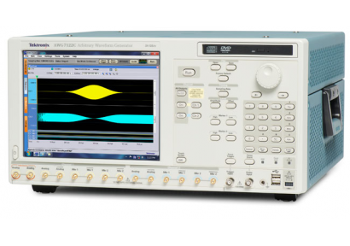
BEYOND THE SIMPLE CASES: HIGH LEVEL PROGRAMMING
USE ABSTRACTIONS TO:
- encapsulate machine
details
- enable complex automation/calibration
- permit arbitrary changes in hardware
“spin”
“microwave generator”
“pulse
sequence”
“spin
coupler”
“ADC”
“spin
measurement”

Slide 11
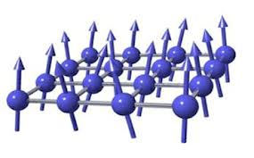
STABILIZATION/ FEEDBACK
Configurable Quantum Network
N = 1 - 100
Trapped Ions
Ultracold Atoms
Superconducting Circuits
Can control:
(i) lattice size & topology
(ii) Local spin state
(iii) coupling
(iv) measurement
COMPUTER
SCIENCE
MEASUREMENT
ENCODE
DECODE
MATERIALS
SCIENCE
VERIFICATION
STAT/
THERMO
ERRORS
CHEMISTRY
VALIDATION
(cf. classical)
ADVANCED
MATERIALS
Configurable Quantum Networks for Advanced Computing (CoQuNAC)

Slide 12
QUESTIONS OF INTEREST
What types of Hamiltonia are accessible with CoQuNAC?
Emulation versus simulation with gates?
How does one “program” the simulation? (ie. map to Hamiltonian)
What parts of the network need to be measured? How?
How to protect against errors?
How to define success/completion?
How to compare to classical solvers?
Benefits of quantum coherence? (cf. AQC, Annealing: Vazirani)
How far can this technique be extended (resources/utility)?
How do we serve the scientific community at large?

