Slide 1
Quantum Software Architecture: Mapping Quantum Algorithms to Devices
February 17, 2015
ASCR 2015
Krysta Svore
Quantum Architectures and Computation Group (QuArC)
Microsoft Research

Slide 2
Requirements for quantum computation
Quantum algorithms:
Design real-world quantum algorithms for small-, medium- and large-scale quantum computers
Quantum hardware architecture:
Architect a scalable, fault-tolerant, and fully programmable quantum computer
Quantum software architecture:
Program and compile complex algorithms into optimized, target-dependent (quantum and classical) instructions
Microsoft Proprietary

Slide 3
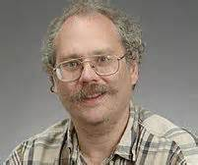
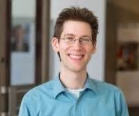
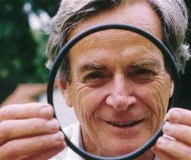
Quantum Algorithms Exist!
Shor’s Algorithm (1994)
Breaks RSA, elliptic curve signatures, DSA, El-Gamal
Exponential speedups
Solving Linear Systems of Equations (2010)
Applications shown for electromagnetic wave scattering
Exponential speedups
Quantum simulation (1982)
Simulate physical systems in a quantum mechanical device
Exponential speedups
Microsoft Proprietary

Slide 4
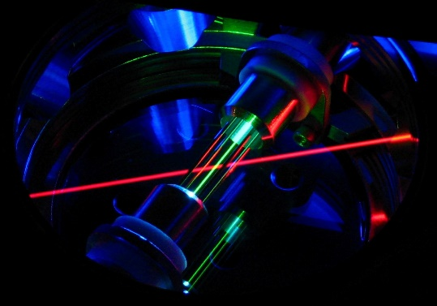
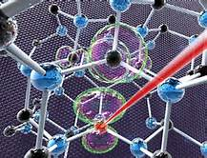
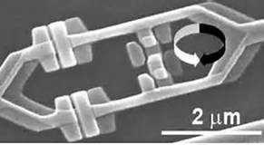
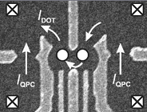
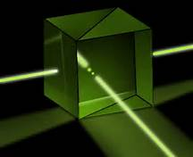
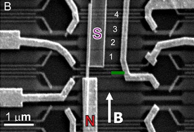
Quantum Hardware Technologies Exist!
Ion traps
NV centers
Super-conductors
Quantum dots
Linear optics
Topological
Microsoft Proprietary

Slide 5
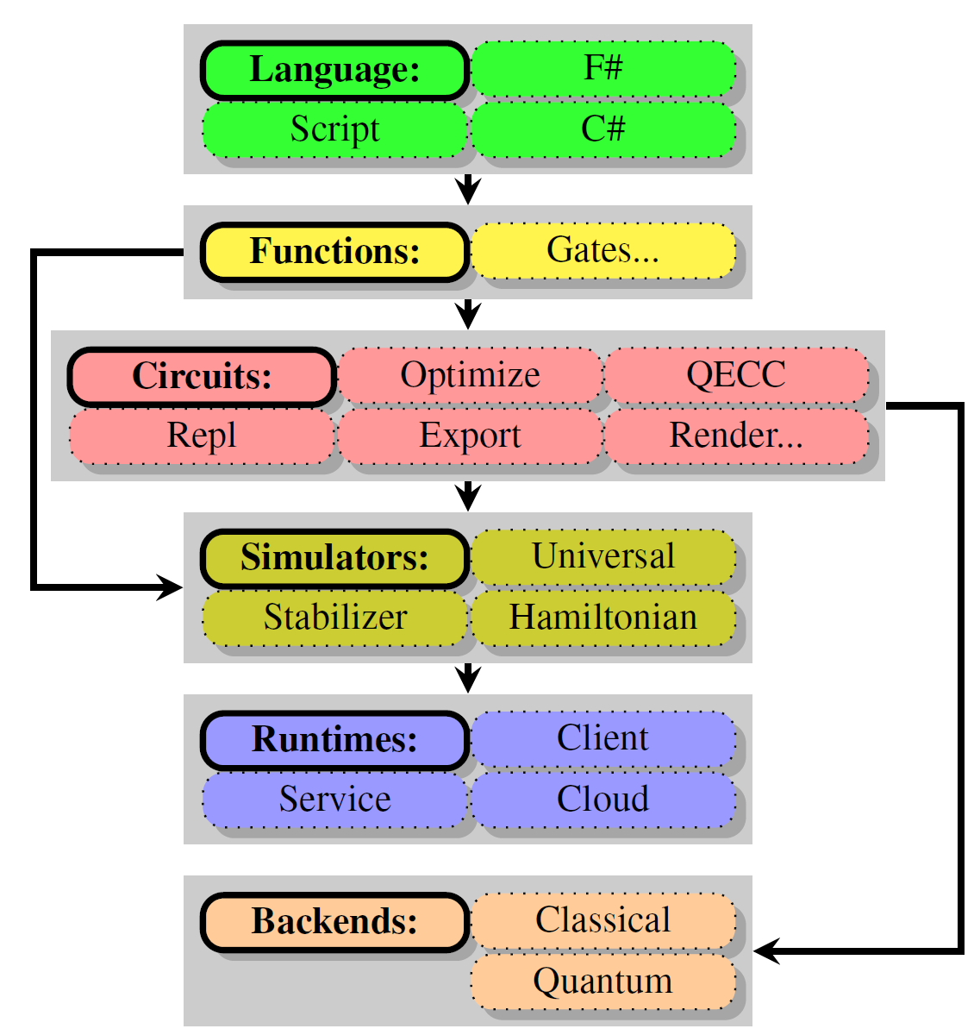
A Software Architecture for Quantum Computing
High-level Quantum Algorithm
Quantum Gates
Quantum Function Implementation
Models:
Quantum annealing
Adiabatic
Circuit
Quantum Circuit Decomposition
Quantum Circuit Optimization
Quantum Error Correction
Simulation
Runtime Environments
Target-dependent Optimization
Layout, Scheduling, Control
Target-dependent Representation
Classical Control/Quantum Machine Instructions
The LIQ$Ui|⟩ \text{platform}$
[Wecker and Svore, 2014]
Benchmarking / Test Suites
Microsoft Proprietary

Slide 6
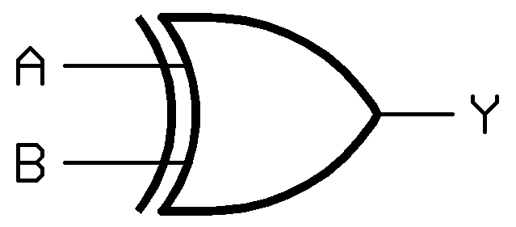
Quantum Gates: Digital quantum computation
Basic unit: qubit = unit vector
$$α\left|0\right\rangle +β\left|1\right\rangle$$
Computing: unitary operation
Description: unitary matrix
Basic unit: bit = 0 or 1
Computing: logical operation
Description: truth table
A | B | Y
0 | 0 | 0
0 | 1 | 1
1 | 0 | 1
1 | 1 | 0
$$\left[\begin{matrix}1 & 0 & 0 & 0 \\ 0 & 1 & 0 & 0 \\ 0 & 0 & 0 & 1 \\ 0 & 0 & 1 & 0\end{matrix}\right]$$
XOR gate
CNOT gate
Microsoft Proprietary

Slide 7
Classical vs. Quantum Computing
Basic unit: bit = 0 or 1
Computing: logical operation
Description: truth table
Direction: Most gates only run forward
Copying: Independent copies are easy
Noise: Manageable with minimal ECC
Input/Output: Linear
Storage: n bits hold 1 value from 0 to $2^{n}−1$
Computation:
An n-bit ALU: 1 operation/cycle
Basic unit: qubit = unit vector $α\left|0\right\rangle +β\left|1\right\rangle$
Computing: unitary operation
Description: unitary matrix
Direction: Most gates are reversible (matrices)
Copying: Independent copies are impossible
Noise: Difficult to overcome. Sophisticated QECC
Input: Linear, Output: Probabilistic
Storage: n qubits can hold $2^{n}$ values
Computation:
An n-qubit ALU: $2^{n}$ operations/cycle
Microsoft Proprietary

Slide 8
Goals of a Software Architecture
Simulation:
High (enough) level language to easily implement large quantum algorithms
Enable as large a simulation on classical computers as possible
Support abstraction and visualization to help the user
Implement as an extensible platform so users can tailor to their own requirements
Compilation:
Multi-level analysis of circuits to allow many types of optimization
Circuit re-writing for specific needs (e.g., different gate sets, noise modeling)
Compilation into real target architectures (e.g., physics experiments)
Microsoft Proprietary
[Wecker and Svore 2014]

Slide 9
Languages for expressing logical quantum circuits
Example: QFT on 5 qubits
.qc
QASM
Quipper
QuIGL
[Lapets and Roetteler 2013]
.v 1 2 3 4 5 6
.i 1 2 3 4 5 6
.o 1 2 3 4 5 6
.ol
.c
BEGIN
H 1
RZ(1 pi/2) 2 1
H 2
RZ(1 pi/4) 3 1
RZ(1 pi/2) 3 2
H 3
RZ(1 pi/8) 4 1
RZ(1 pi/4) 4 2
RZ(1 pi/2) 4 3
H 4
RZ(1 pi/16) 5 1
RZ(1 pi/8) 5 2
RZ(1 pi/4) 5 3
RZ(1 pi/2) 5 4
H 5
RZ(1 pi/32) 6 1
RZ(1 pi/16) 6 2
RZ(1 pi/8) 6 3
RZ(1 pi/4) 6 4
RZ(1 pi/2) 6 5
H 6;
END
defbox CU,3,1,'U'
defbox CU2,3,1,'U^2'
defbox CU4,3,1,'U^4'
def c-S,1,'S'
def c-T,1,'T'
qubit j0,0 # QFT qubits
qubit j1,0
qubit j2,0
qubit s0 # U qubits
qubit s1
h j0 # equal superposition
h j1
h j2
CU4 j0,s0,s1 # controlled-U
CU2 j1,s0,s1
CU j2,s0,s1
h j0 # QFT
c-S j0,j1
h j1
nop j0
c-T j0,j2
c-S j1,j2
h j2
nop j0
nop j0
Nop j1
qft' :: [Qubit] -> Circ [Qubit]
qft' [] = return []
qft' [x] = do
hadamard x
return [x]
qft' (x:xs) = do
xs' <- qft' xs
xs'' <- rotations x xs' (length xs')
x' <- hadamard x
return (x':xs'')
where
rotations _ [] _ = return []
rotations c (q:qs) n = do
qs' <- rotations c qs n
let m = ((n + 1) - length qs)
q' <- rGate m q `controlled` c
return (q':qs')
circuit {
q := wire [5];
H (q[1]);
control (q[1]) {
phase (q[2]);
};
H (b);
control (q[1]) {
T (q[3]);
};
control (q[2]) { phase (q[3]); };
H (c);
control (q[1]) {
phaseZ [pi/8, 10^(-3)] (q[4]);
};
control (q[2]) {
T (q[4]);
};
control (q[3]) {
phase (q[4]);
};
H (q[4]);
control (q[1]) {
phaseZ [pi/16, 10^(-3)] (q[5]z);
};
control (q[2]) {
phaseZ [pi/8, 10^(-3)] (q[5]);
};
control (q[3]) {
T (q[5]);
};
control (q[4]) {
phase (q[5]);
};
H (q[5]);
}
[Selinger and Valiron 2013]
[Cross 2005]
Low-level, assembly like languages
High-level, embedded languages
Microsoft Proprietary

Slide 10
Teleport: Quantum “Hello World”
Define a function to perform entanglement:
let EPR (qs:Qubits) = H qs; CNOT qs
The rest of the algorithm:
let teleport (qs:Qubits) =
let qs' = qs.Tail
EPR qs'; CNOT qs; H qs
M qs'; BC X qs'
M qs ; BC Z !!(qs,0,2)
Microsoft Proprietary
[Wecker and Svore 2014]

Slide 11
Teleport: Running the Code
loop N times:
… create 3 qubits
… init the first one to a random state
… print it out
teleport qs
… print out the result
0:0000.0/Initial State: ( 0.3735-0.2531i)|0>+( -0.4615-0.7639i)|1>
0:0000.0/Final State: ( 0.3735-0.2531i)|0>+( -0.4615-0.7639i)|1> (bits:10)
0:0000.0/Initial State: ( -0.1105+0.3395i)|0>+( 0.927-0.1146i)|1>
0:0000.0/Final State: ( -0.1105+0.3395i)|0>+( 0.927-0.1146i)|1> (bits:11)
0:0000.0/Initial State: ( -0.3882-0.2646i)|0>+( -0.8092+0.3528i)|1>
0:0000.0/Final State: ( -0.3882-0.2646i)|0>+( -0.8092+0.3528i)|1> (bits:01)
0:0000.0/Initial State: ( 0.2336+0.4446i)|0>+( -0.8527+0.1435i)|1>
0:0000.0/Final State: ( 0.2336+0.4446i)|0>+( -0.8527+0.1435i)|1> (bits:10)
0:0000.0/Initial State: ( 0.9698+0.2302i)|0>+(-0.03692+0.0717i)|1>
0:0000.0/Final State: ( 0.9698+0.2302i)|0>+(-0.03692+0.0717i)|1> (bits:11)
0:0000.0/Initial State: ( -0.334-0.3354i)|0>+( 0.315-0.8226i)|1>
0:0000.0/Final State: ( -0.334-0.3354i)|0>+( 0.315-0.8226i)|1> (bits:01)
Microsoft Proprietary

Slide 12
User definition of a gate
/// <summary>
/// Controlled NOT gate
/// </summary>
/// <param name="qs"> Use first two qubits for gate</param>
[<LQD>]
let CNOT (qs:Qubits) =
let gate =
Gate.Build("CNOT",fun () ->
new Gate(
Name = "CNOT",
Help = "Controlled NOT",
Mat = CSMat(4,[(0,0,1.,0.);(1,1,1.,0.);
(2,3,1.,0.);(3,2,1.,0.)]),
Draw = "\\ctrl{#1}\\go[#1]\\targ"
))
gate.Run qs
Microsoft Proprietary
[Wecker and Svore 2014]

Slide 13
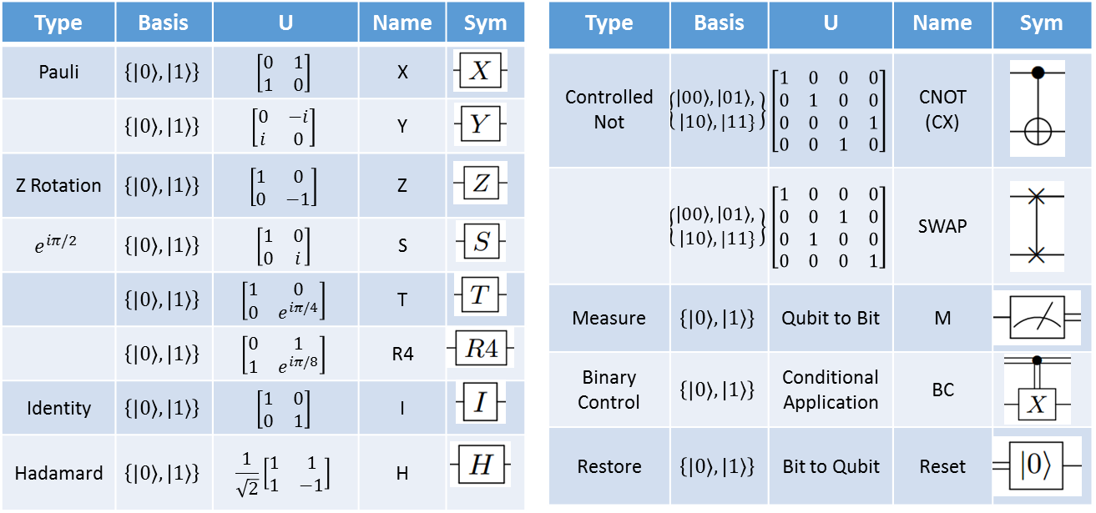
Quantum Gate Library
Microsoft Proprietary

Slide 14
Shor’s algorithm: Modular Adder
As defined in:
Circuit for Shor’s
algorithm using 2n+3 qubits
– Stéphane Beauregard
let op (qs:Qubits) =
CCAdd a cbs // Add a to $Φ|b⟩$
AddA' N bs // Sub N from $Φ|a+b⟩$
QFT' bs // Inverse QFT of $Φ|a+b−N⟩$
CNOT [bMx;anc] // Save top bit in Ancilla
QFT bs // QFT of a+b-N
CAddA N (anc :: bs) // Add back N if negative
CCAdd' a cbs // Subtract a from $Φ|a+b mod N⟩$
QFT' bs // Inverse QFT
X [bMx] // Flip top bit
CNOT [bMx;anc] // Reset Ancilla to $|0⟩$
X [bMx] // Flip top bit back
QFT bs // QFT back
CCAdd a cbs // Finally get $Φ|a+b mod N⟩$
Microsoft Proprietary

Slide 15
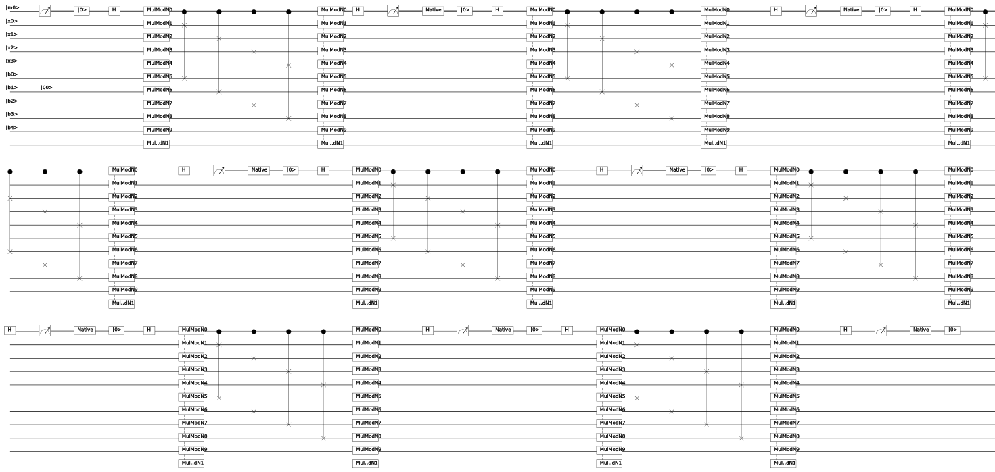
Shor’s algorithm: Full Circuit - 4 bits $≅$ 8200 gates
Largest we’ve done:
14 bits (factoring 8193)
14 Million Gates
30 days
Circuit for Shor’s algorithm using 2n+3 qubits – Stéphane Beauregard
Microsoft Proprietary

Slide 16
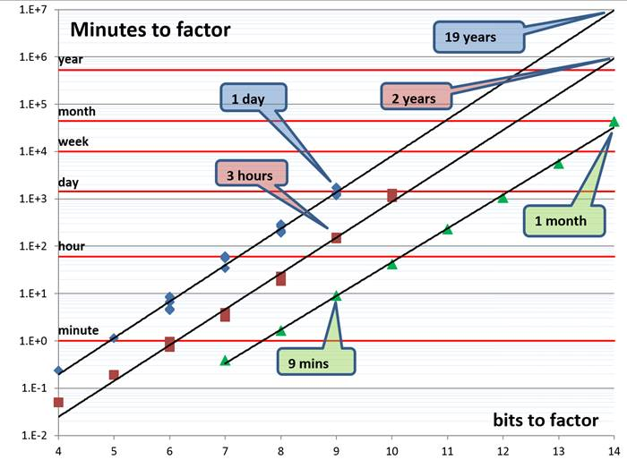
Shor’s algorithm simulation
Microsoft Proprietary

Slide 17
Quantum Chemistry
$$H=\sum_{pq}{h_{pq}a_{p}^{†}a_{q}+\frac{1}{2}\sum_{pqrs}{h_{pqrs }a_{p}^{†}a_{q}^{†}a_{r}a_{s}}}$$
Can quantum chemistry be performed on a small quantum computer: Dave Wecker, Bela Bauer, Bryan K. Clark, Matthew B. Hastings, Matthias Troyer
As quantum computing technology improves and quantum computers with a small but non-trivial number of N > 100 qubits appear feasible in the near future the question of possible applications of small quantum computers gains importance. One frequently mentioned application is Feynman's original proposal of simulating quantum systems, and in particular the electronic structure of molecules and materials. In this paper, we analyze the computational requirements for one of the standard algorithms to perform quantum chemistry on a quantum computer. We focus on the quantum resources required to find the ground state of a molecule twice as large as what current classical computers can solve exactly. We find that while such a problem requires about a ten-fold increase in the number of qubits over current technology, the required increase in the number of gates that can be coherently executed is many orders of magnitude larger. This suggests that for quantum computation to become useful for quantum chemistry problems, drastic algorithmic improvements will be needed.
http://arxiv.org/abs/1312.1695
Improving Quantum Algorithms for Quantum Chemistry: M. B. Hastings, D. Wecker, B. Bauer, M. Troyer
We present several improvements to the standard Trotter-Suzuki based algorithms used in the simulation of quantum chemistry on a quantum computer. First, we modify how Jordan-Wigner transformations are implemented to reduce their cost from linear or logarithmic in the number of orbitals to a constant. Our modification does not require additional ancilla qubits. Then, we demonstrate how many operations can be parallelized, leading to a further linear decrease in the parallel depth of the circuit, at the cost of a small constant factor increase in number of qubits required. Thirdly, we modify the term order in the Trotter-Suzuki decomposition, significantly reducing the error at given Trotter-Suzuki timestep. A final improvement modifies the Hamiltonian to reduce errors introduced by the non-zero Trotter-Suzuki timestep. All of these techniques are validated using numerical simulation and detailed gate counts are given for realistic molecules.
http://arxiv.org/abs/1403.1539
Ferredoxin ($Fe_{2}S_{2}$) used in many metabolic reactions
including energy transport in photosynthesis
Intractable on a classical computer
Assumed quantum scaling: ~24 billion years ($N^{11}$ scaling)
First paper: ~850 thousand years to solve ($N^{9}$ scaling)
Second paper: ~30 years to solve ($N^{7}$ scaling)
Third paper: ~5 days to solve ($N^{5.5}$ scaling)
Fourth paper: ~1 hour to solve ($N^{3},Z^{2.5}$ scaling)
The Trotter Step Size Required for Accurate Quantum Simulation of Quantum Chemistry
David Poulin, M. B. Hastings, Dave Wecker, Nathan Wiebe, Andrew C. Doherty, Matthias Troyer
The simulation of molecules is a widely anticipated application of quantum computers. However, recent studies \cite{WBCH13a,HWBT14a} have cast a shadow on this hope by revealing that the complexity in gate count of such simulations increases with the number of spin orbitals N as N8, which becomes prohibitive even for molecules of modest size N∼100. This study was partly based on a scaling analysis of the Trotter step required for an ensemble of random artificial molecules. Here, we revisit this analysis and find instead that the scaling is closer to N6 in worst case for real model molecules we have studied, indicating that the random ensemble fails to accurately capture the statistical properties of real-world molecules. Actual scaling may be significantly better than this due to averaging effects. We then present an alternative simulation scheme and show that it can sometimes outperform existing schemes, but that this possibility depends crucially on the details of the simulated molecule. We obtain further improvements using a version of the coalescing scheme of \cite{WBCH13a}; this scheme is based on using different Trotter steps for different terms. The method we use to bound the complexity of simulating a given molecule is efficient, in contrast to the approach of \cite{WBCH13a,HWBT14a} which relied on exponentially costly classical exact simulation.
http://arxiv.org/abs/1406.4920
On the Chemical Basis of Trotter-Suzuki Errors in Quantum Chemistry Simulation
Ryan Babbush, Jarrod McClean, Dave Wecker, Alán Aspuru-Guzik, Nathan Wiebe
Although the simulation of quantum chemistry is one of the most anticipated applications of quantum computing, the scaling of known upper bounds on the complexity of these algorithms is daunting. Prior work has bounded errors due to Trotterization in terms of the norm of the error operator and analyzed scaling with respect to the number of spin-orbitals. However, we find that these error bounds can be loose by up to sixteen orders of magnitude for some molecules. Furthermore, numerical results for small systems fail to reveal any clear correlation between ground state error and number of spin-orbitals. We instead argue that chemical properties, such as the maximum nuclear charge in a molecule and the filling fraction of orbitals, can be decisive for determining the cost of a quantum simulation. Our analysis motivates several strategies to use classical processing to further reduce the required Trotter step size and to estimate the necessary number of steps, without requiring additional quantum resources. Finally, we demonstrate improved methods for state preparation techniques which are asymptotically superior to proposals in the simulation literature.
http://arxiv.org/abs/1410.8159
Microsoft Proprietary

Slide 18
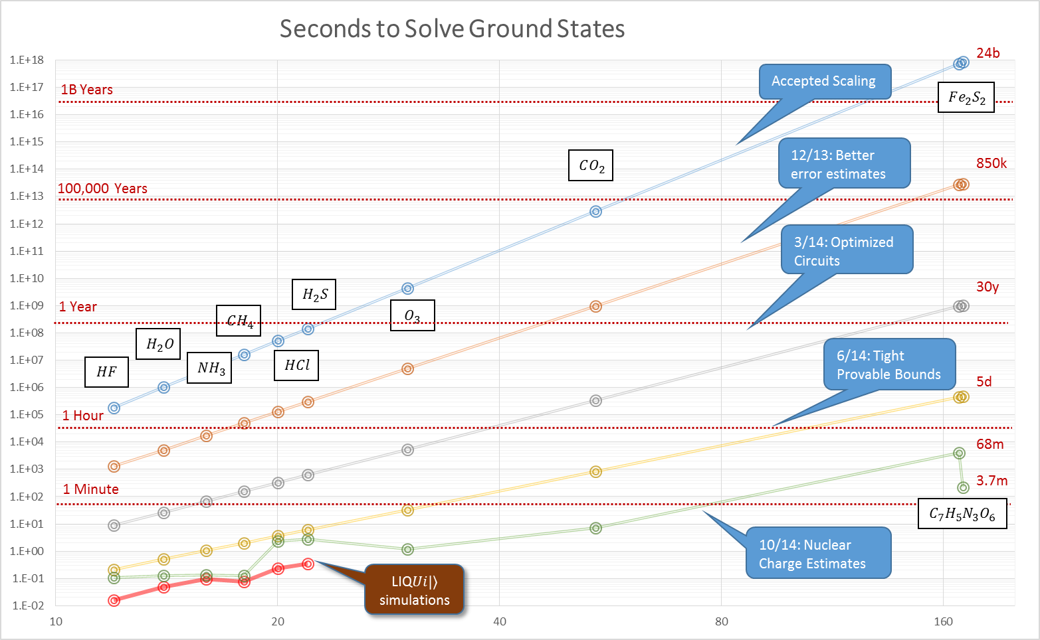
Quantum Chemistry
$$H=\sum_{pq}{h_{pq}a_{p}^{†}a_{q}+\frac{1}{2}\sum_{pqrs}{h_{pqrs }a_{p}^{†}a_{q}^{†}a_{r}a_{s}}}$$
Microsoft Proprietary

Slide 19
Quantum Hardware: What’s the catch?
Need coherent
control
Need strongly
interacting system
$$|ψ_{1}〉$$
$$|ψ_{2}〉$$
$$|ψ_{0}〉$$
$$|ψ_{3}〉$$
Avoid interaction with
outside environment!
Can’t perform an
arbitrary size unitary!
(coming in Part II)
$$|ψ_{4}〉$$
Decoherence
and errors!
Slide credit: Rob Schoelkopf
Microsoft Proprietary

Slide 20
Classical Error Correction
0
1-p
0
p
Probability p of having
a bit flipped
Sent
Received
p
1
1
1-p
Repetition code: redundantly encode, majority voting
0 000
1 111
Reduces classical error rate to 3p² – 2p³
Can we do this for quantum computing? Maybe not:
“No cloning” theorem
Errors seem to be continuous
Measurements change the state
Slide credit: Rob Schoelkopf
Microsoft Proprietary

Slide 21
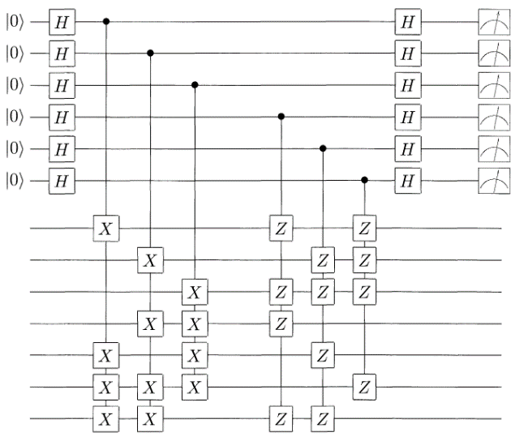
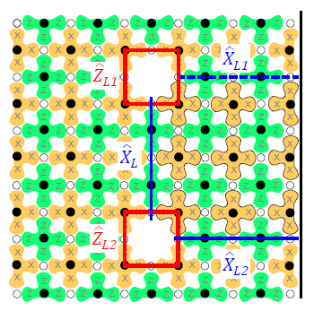
Error Correction Architectures
Standard QEC
Surface Code
Modular Approach
…
Switchable Router
…
Overhead required in known schemes: 1,000s physical qubits for every logical qubit
7 or 9 physical qubits per logical (+ concatenation!)
threshold ~ 10⁻⁴
many operations, syndromes per QEC cycle
10² – 10⁴ /logical
threshold ~ 1%
simulate large system to see effects
few qubits/ module
good local gates (10⁻⁴?) remote gates fair (90%?)
possible to construct QEC as software layer
Slide credit: Rob Schoelkopf
Microsoft Proprietary

Slide 22
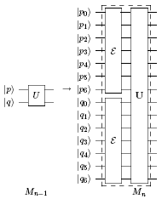
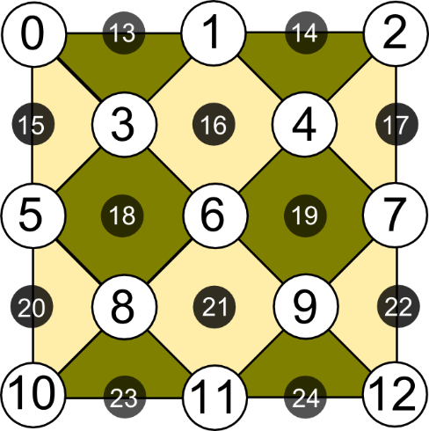
Fault-tolerant Replacement Rules
Given a set of fault-tolerant replacement rules:
Replace each circuit location with a fault-tolerant gadget
25 qubits
Fault-tolerant replacement rules have been developed for a discrete, universal set of gates
(e.g., Clifford + T, Clifford + Toffoli)
X_{L}
Z_{L}
Microsoft Proprietary

Slide 23
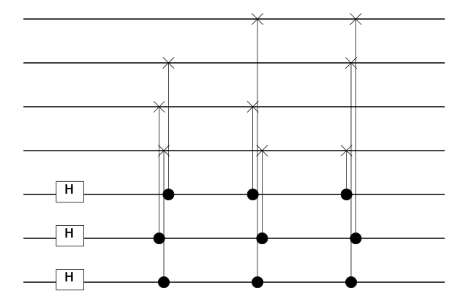
Gate Definition: Steane [[7,1,3]] Prep. Rule
/// <summary>
/// Adjoint of parent gate.
/// </summary>
/// <param name="qs"> Qubits to use with parent gate</param>
[<LQD>] /// Prep gate for Steane7
let prep (qs:Qubits) =
let nam = "S7_Prep"
let nam2= "S7\nPrep"
let gate (qs:Qubits) =
// Create logical |0> prep circuit
let op (qs:Qubits) =
let xH i = H [qs.[i]]
let xC i j = CNOT [qs.[i];qs.[j]]
xH 6; xC 6 3; xH 5; xC 5 2; xH 4
xC 4 1; xC 5 3; xC 4 2; xC 6 0; xC 6 1
xC 5 0; xC 4 3
Gate.Build(nam,fun () ->
new Gate(
Qubits = qs.Length,
Name = nam,
Help = "Prepare logical 0 state",
Render = [Multi(List.init qs.Length
(fun _ -> nam2))],
Op = WrapOp op
))
(gate qs).Run qs
Microsoft Proprietary

Slide 24
Full Teleport Circuit in Steane [[7,1,3]] Code
3 qubits encoded in 27
Microsoft Proprietary

Slide 25
Stabilizer Simulation
let tele1 (qs:Qubits) = X qs; teleport qs; M [qs.[2]]
let tgtC1 = Circuit.Compile tele1 qs
let s7 = Steane7(tgtC1)
let s7C = s7.Circuit
let stab = Stabilizer(s7c,s7.Ket)
stab.Run()
let bit0,dist0 = s7.Log2Phys 0 |> s7.Decode
let bit1,dist1 = s7.Log2Phys 1 |> s7.Decode
let bit2,dist2 = s7.Log2Phys 2 |> s7.Decode
> LIQUiD -test qecc
0:0000.0/LOOP[Zer0]: InjectedXYZ(0,0,0) Fixes=0 (Zero, One,Zero) dist=(0,0,0)
0:0000.0/LOOP[Zer1]: InjectedXYZ(0,1,0) Fixes=2 ( One,Zero,Zero) dist=(0,0,0)
0:0000.0/LOOP[Zer2]: InjectedXYZ(0,1,1) Fixes=2 (Zero,Zero,Zero) dist=(0,0,0)
0:0000.0/LOOP[Zer3]: InjectedXYZ(0,1,1) Fixes=0 (Zero,Zero,Zero) dist=(0,0,1)
0:0000.0/LOOP[Zer4]: InjectedXYZ(1,1,0) Fixes=3 (Zero, One,Zero) dist=(0,0,0)
0:0000.0/LOOP[Zer5]: InjectedXYZ(1,0,0) Fixes=2 ( One,Zero,Zero) dist=(0,0,0)
0:0000.0/LOOP[Zer6]: InjectedXYZ(0,1,0) Fixes=2 (Zero, One,Zero) dist=(0,0,0)
0:0000.1/LOOP[Zer7]: InjectedXYZ(1,0,0) Fixes=1 ( One,Zero,Zero) dist=(0,0,0)
0:0000.1/LOOP[Zer8]: InjectedXYZ(1,1,0) Fixes=3 ( One,Zero,Zero) dist=(0,0,0)
0:0000.1/LOOP[Zer9]: InjectedXYZ(0,1,0) Fixes=1 ( One, One,Zero) dist=(0,0,0)
0:0000.1/LOOP[One0]: InjectedXYZ(0,0,0) Fixes=0 (Zero, One, One) dist=(0,0,0)
0:0000.1/LOOP[One1]: InjectedXYZ(1,0,0) Fixes=1 (Zero, One, One) dist=(0,0,0)
0:0000.1/LOOP[One2]: InjectedXYZ(0,0,1) Fixes=1 ( One, One, One) dist=(0,0,0)
0:0000.1/LOOP[One3]: InjectedXYZ(0,1,1) Fixes=3 (Zero,Zero, One) dist=(0,0,0)
0:0000.1/LOOP[One4]: InjectedXYZ(0,0,1) Fixes=1 ( One, One, One) dist=(0,0,0)
0:0000.1/LOOP[One5]: InjectedXYZ(0,0,1) Fixes=1 ( One,Zero, One) dist=(0,0,0)
0:0000.1/LOOP[One6]: InjectedXYZ(1,0,0) Fixes=1 (Zero,Zero, One) dist=(0,0,0)
0:0000.1/LOOP[One7]: InjectedXYZ(0,1,0) Fixes=1 (Zero, One, One) dist=(0,0,0)
0:0000.1/LOOP[One8]: InjectedXYZ(1,0,1) Fixes=0 (Zero,Zero, One) dist=(0,0,1)
0:0000.1/LOOP[One9]: InjectedXYZ(1,1,0) Fixes=3 (Zero, One, One) dist=(0,0,0)
Microsoft Proprietary

Slide 26
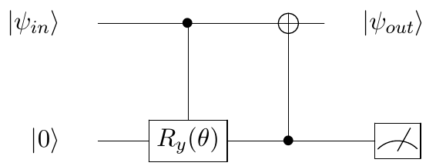
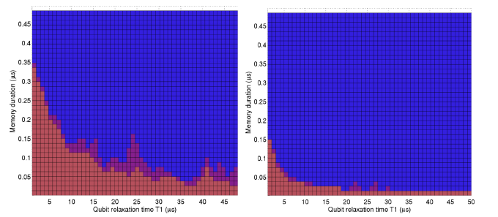
Advanced Noise Modeling
Noise(circ:Circuit,ket:Ket,models:NoiseModels)
type NoiseModel = {
gate: string // Gate name (ending with "*" for wildcard match)
maxQs: int // Max qubits that gate uses
time: float // floating duration of gate (convention Idle = 1.0)
func: NoiseFunc // Noise Model to execute
gateEvents: NoiseEvents // Stats for normal gates
ecEvents: NoiseEvents // Stats for EC gates
}
member n.DampProb // Get/Set damping probability on a qubit
Microsoft Proprietary

Slide 27
Quantum compiling
Quantum algorithm
Quantum computer
Microsoft Proprietary

Slide 28
Quantum compiling
Quantum algorithm
Quantum computer
Error correction
{ ,H,T}
Microsoft Proprietary

Slide 29
Quantum compiling
Quantum algorithm
[Barenco et al., 1995]
Quantum computer
Error correction
{ ,H,T}
Microsoft Proprietary

Slide 30
Quantum compiling
Quantum algorithm
Quantum computer
Error correction
{ ,H,T}
Microsoft Proprietary

Slide 31
Quantum compiling
Quantum algorithm
Arbitrary rotation about a given axis
We do not have methods to error-correct an arbitrary rotation!
Solution: Approximate with a sequence of gates from a “correctable” set of operations
Quantum computer
Error correction
{ ,H,T}
Microsoft Proprietary

Slide 32
Quantum compiling
Quantum algorithm
Quantum computer
Error correction
{ ,H,T}
Microsoft Proprietary

Slide 33
Quantum compiling
Quantum algorithm
≈ HTHTHTHTHTHTHTH
THTHTHTHTHTHTH...
Quantum computer
Error correction
{ ,H,T}
Microsoft Proprietary

Slide 34
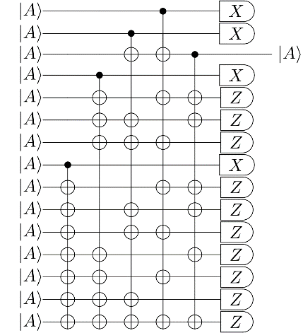
Quantum compiling
Quantum algorithm
≈ HTHTHTHTHTHTHTH
THTHTHTHTHTHTH...
Quantum computer
Error correction
{ ,H,T}
Microsoft Proprietary

Slide 35
Quantum compiling
Quantum algorithm
≈ HTHTHTHTHTHTHTH
THTHTHTHTHTHTH...
Quantum computer
Error correction
{ ,H,T}
Microsoft Proprietary

Slide 36
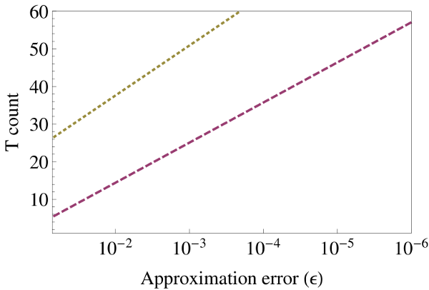
Quantum compiling
Quantum algorithm
Axial rotations
[Selinger 2012]
[Kliuchnikov,Maslov, Mosca 2012]
worst case
≈ HTHTHTHTHTHTHTH
THTHTHTHTHTHTH...
“average” case
Quantum computer
Quantum computer
Error correction
repeat-until-success
{ ,H,T}
Microsoft Proprietary

Slide 37
Instruction Sets: Universal Single-qubit Bases
$T$ + Clifford ($H,X,Y,Z,I,S$)
$$T= \left[\begin{matrix}1 & 0 \\ 0 & e^{iπ/4}\end{matrix}\right]$$
$V_{3}$ + Clifford ($H,X,Y,Z,I,S$)
$$V_{3}=\frac{1}{\sqrt{5}}\left[\begin{matrix}1+2i & 0 \\ 0 & 1−2i\end{matrix}\right]$$
Fibonacci anyon basis:
$${{ σ}_{1}=\left[\begin{matrix}−ω & 0 \\ 0 & ω^{3}\end{matrix}\right], σ}_{2}=\left[\begin{matrix}ω^{4}τ & −ω^{2}\sqrt{τ} \\ −ω^{2}\sqrt{τ} & −τ\end{matrix}\right],$$
$$ω=e^{iπ/5}, τ=\frac{\sqrt{5} −1}{2}$$
$$H$$
$$T$$
$$S$$
$$Z$$
$$X$$
$$H$$
$$V$$
$$S$$
$$Z$$
$$X$$
Microsoft Proprietary

Slide 38
Single-qubit unitary approximation
Input
$U$: 2x2 unitary matrix (assume a z-rotation by angle $θ$)
$U= \left[\begin{matrix}1 & 0 \\ 0 & e^{iθ}\end{matrix}\right]$
$ε$: approximation error
Output
$G_{1},G_{2},…, G_{l}$: sequence of gates
Constraint
$\left|\left|U−G_{1}G_{2}…G_{l}\right|\right|≤ε$
$$G_{1},G_{2},…, G_{l}∈\{CNOT, H, S, T\}$$
$$S=\frac{π}{2}$$
$$T=\frac{π}{4}$$
Microsoft Proprietary

Slide 39
Solovay-Kitaev Theorem
$$H$$
$$T$$
$$S$$
$$Z$$
$$X$$
Two important complexities are implied
Cost for finding the sequence, i.e., classical compilation time
Cost of the sequence, i.e., the length of the word over the instruction set
Microsoft Proprietary
[Source: Dawson, Nielsen, quant-ph/0505030]

Slide 40
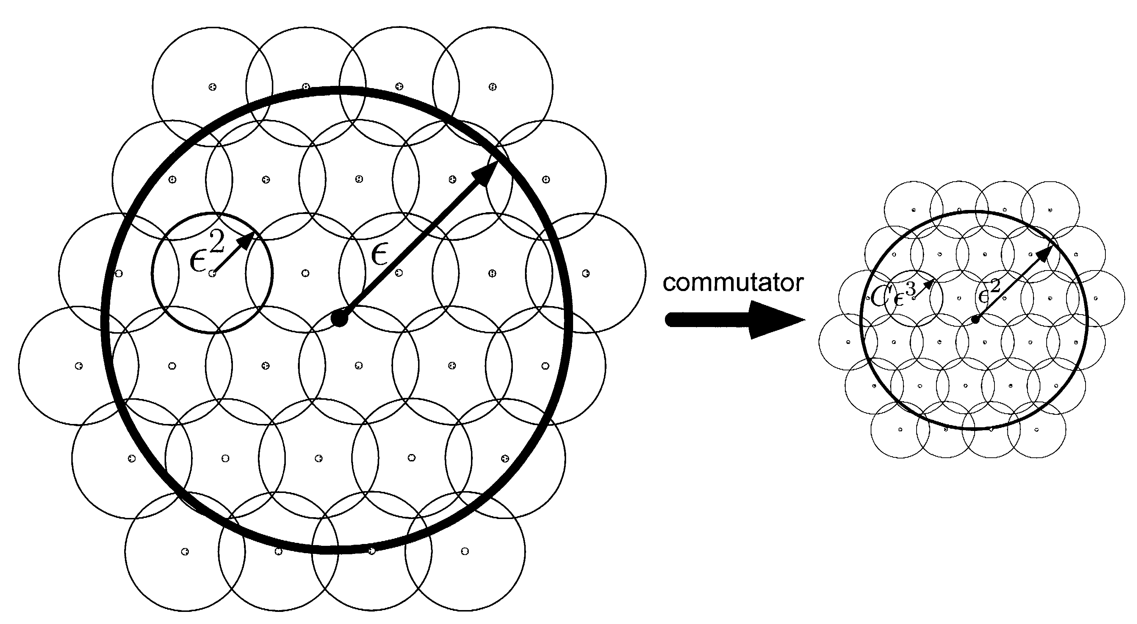
Solovay-Kitaev Algorithm: de facto standard until 2012!
Basic idea: Successive refining of a net using commutators
Implementations:
[Kitaev, Shen, Vyalyi, AMS 2002]: log^{3+δ} (1/ε) time, log^{3+δ}(1/ε) length
w/ancilla: log² (1/ε) log log (1/ε) time, log² (1/ε) log log (1/ε) length
[Dawson, Nielsen, quant-ph/0505030]: log^{2.71} (1/ε) time, log^{3.97} (1/ε) length
[Harrow, Recht, Chuang, quant-ph/0111031]: non-constructive, log (1/ε) length
Microsoft Proprietary
[Image source: Nielsen/Chuang, CUP 2000]

Slide 41
Paper (Date) | Contributions
arXiv:1206.5236 ¹ | Algorithm for exact synthesis of single-qubit unitaries
arXiv:1212.0506 ² | Exact synthesis of multi-qubit unitaries over the ring.
arXiv:1212.0822 ¹ | Exact synthesis of multi-qubit unitaries and number theory for asymptotically optimal approximation using ancillary qubits
arXiv:1212.6253 ² | Poly algorithm for approximating single qubit unitaries using at most 4 log(1/ε) + C T gates. Use of algebraic number theory
arXiv:1212.6964 ¹ | Exhaustive round-off gives better constant of strictly <4.
arXiv:1311.1074 ⁰ | Emergence of RUS designs. Scaling of the constant below 3 but the method uses database and is not efficient.
arXiv:1403.5280 (Duclos-Cianci/Poulin) | Using offline distillation to enhance the underlying gate set. Very efficient compilation algorithm, better constant. Large offline cost.
arXiv:1403.2975² | Using $SL_{2}$ shearings, the constant was improved to 3 log(1/ε).
arXiv:1404.5320 ⁰ | Using integer relation algorithms to find better approximations for z-rotations via RUS designs. Constant improved to 1.15 log(1/ε).
arXiv:1409.3552 ⁰ | Using integer relation algorithms to find better approximations for z-rotations via PQF designs. Constant improved to 1 log(1/ε).
Additional papers show how to solve for other instruction sets (Fibonacci anyons, metaplectic anyons)
⁰ (QuArC) ¹ (Kliuchnikov, Mosca, Maslov) ² (Selinger et al)
Microsoft Proprietary

Slide 42
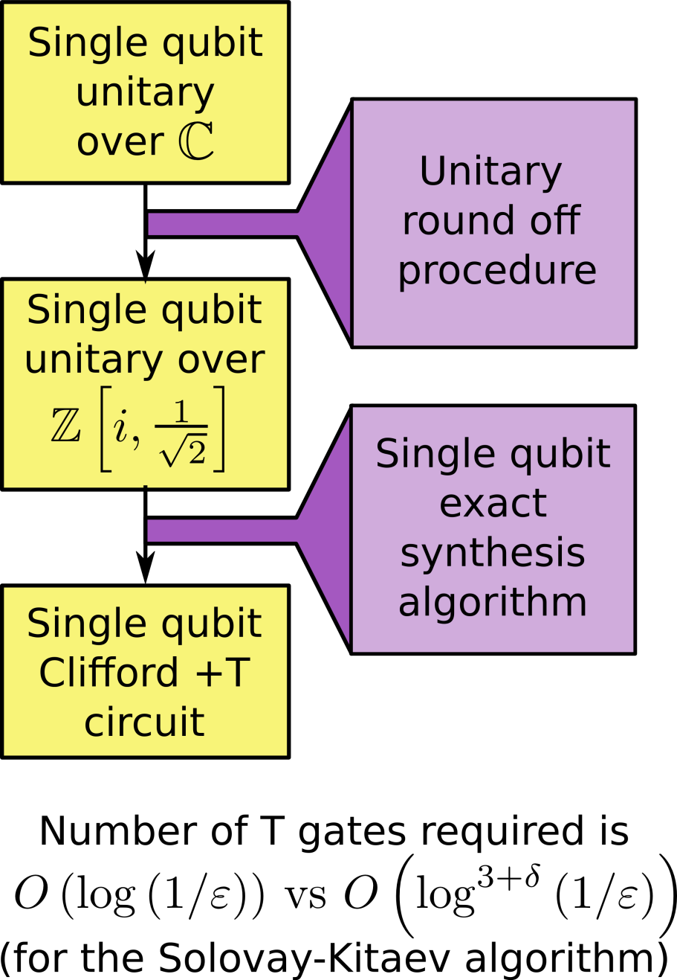
Year 2012: New Synthesis Methods
(based on algebraic number theory)
Microsoft Proprietary
[Kliuchnikov/Maslov/Mosca’12]

Slide 43
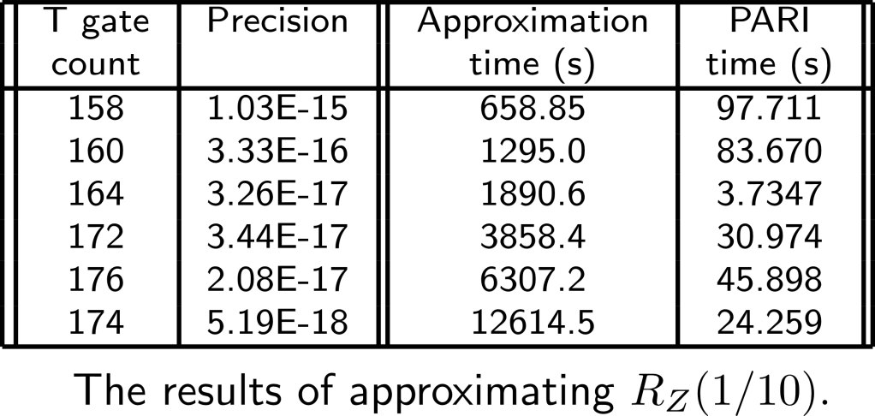
How much cost improvement?
Microsoft Proprietary

Slide 44
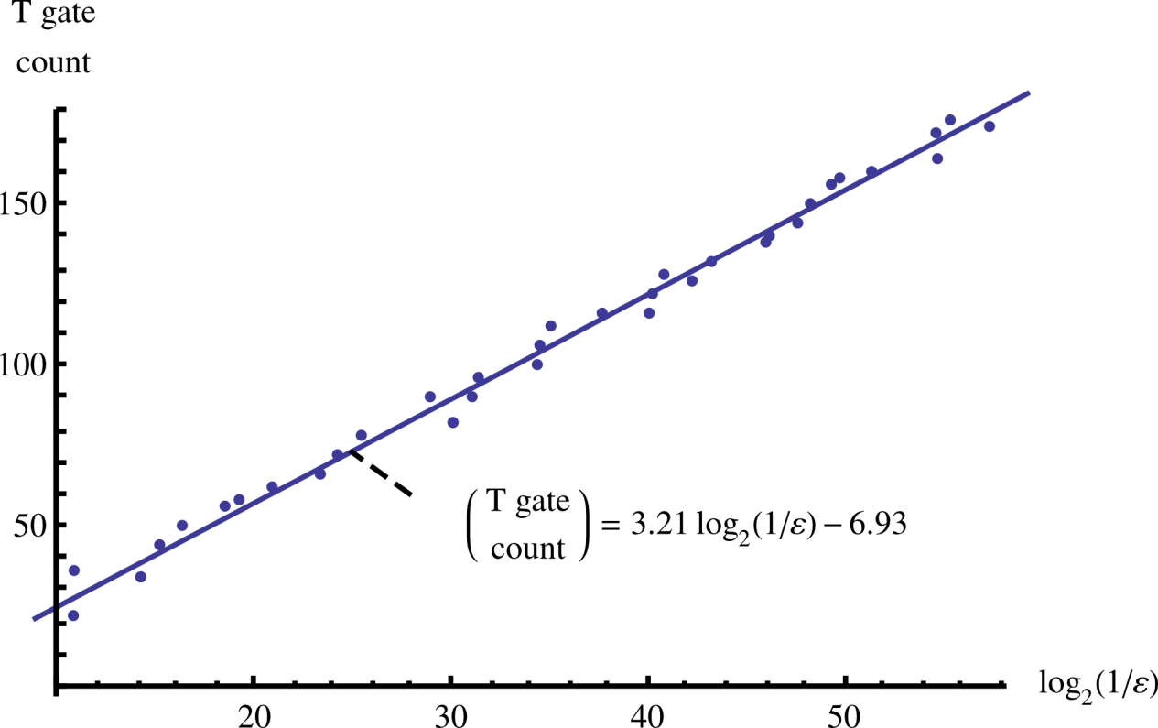
How much cost improvement?
Can we do even better?
Achieve length with c=1 with efficient randomized algorithm
Length vs
precision vs
compile time:
A typical implementation of Solovay-Kitaev algorithm requires 1.5 10⁴ T gates to achieve precision of 10⁻¹⁵
Microsoft Proprietary

Slide 45
Non-deterministic circuits
Exp[T] = 6.4
Outcome 0: $U|ψ〉 \operatorname{Pr}\left[0\right]=5/8$
Outcome 1: $Id|ψ〉 \operatorname{Pr}\left[1\right]=3/8$
$$V_{3}=\frac{1}{\sqrt{5}}\left[\begin{matrix}1+2i & 0 \\ 0 & 1−2i\end{matrix}\right], ε={10}^{−6}$$
Example
HZTHTHTHTHTHTHTHTHTHTHTHTHTHTHTHTHTHTHTHTHTHTSHTHTHTSHT
SHTHTHTSHTSHTSHTSHTSHTHTSHTHTSHTSHTHTHTHTHTHTSHTHTSHTS
HTSHTHTHTHTHTSHTSHTSHTSHTHTHTSHTSHTSHTHTHTSHTSHTSHTSHS
67 T gates
Microsoft Proprietary
[Paetznick and Svore 13; Bocharov, Roetteler, Svore 14]

Slide 46
Non-deterministic circuits
Exp[T] = 6.4
Outcome 0: $U|ψ〉 \operatorname{Pr}\left[0\right]=5/8$
Outcome 1: $Id|ψ〉 \operatorname{Pr}\left[1\right]=3/8$
Repeat-Until-Success
Microsoft Proprietary

Slide 47
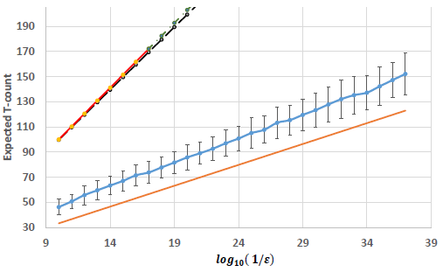
Numerical Results: RUS and PQF
Precision vs. expected $T$-count
1000 random angles
30 target precisions
Success prob. $\sim 0.97$
Maximum likelihood estimate of mean exp. $T$-count for RUS
$$1.149\log_{2}\left(\frac{1}{ε }\right)+9.2$$
Maximum likelihood estimate of mean one-round exp. $T$-count for PQF
$${1 log}_{2}\left(\frac{1}{ε }\right)+4\log_{2}{(\log_{2}\left(\frac{1}{ε}\right))+1.187}$$
Factor of 3 improvement over unitary decomposition!
Surpasses information-theoretic unitary lower bound!
Microsoft Proprietary
[Paetznick and Svore 13; Bocharov, Roetteler, Svore 14]

Slide 48
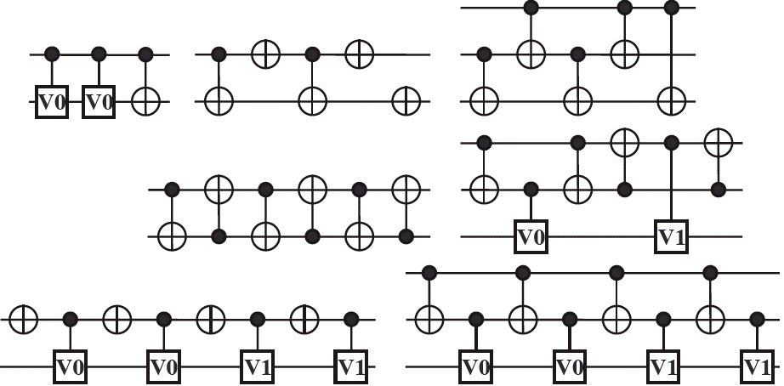
Optimization: rewriting templates
Use string rewriting rules
Basic idea:
Obstacles:
Number of rules grows fast
Some gates may commute
Need good reduction strategies
=
Templates:
[Maslov, Young, Miller, Dueck, Quantum Circuit Simplification Using Templates, DATE’05]
Slide credit: Dmitri Maslov
Microsoft Proprietary

Slide 49
Time-space tradeoffs
Let A be an algorithm with time complexity T and space complexity S
Using reversible pebble games, [Bennett, SIAM J. Comp. 1989] showed that for any ε>0 there is a reversible algorithm A’ with time complexity O(T^{1+ ε}) and space complexity O(S ln(T)).
Issue: one cannot simply take the limit ε→0. The space would grow in an unbounded way (as O(ε2^{1/ε} S ln(T))).
Improved analysis [Levine, Sherman, SIAM J. Comp. 1990] showed that for any ε>0 there is a reversible algorithm A’ with time complexity O(T^{1+ ε}/S ^{ε}) and space complexity O(S (1+ln(T/S))).
Other time/space tradeoffs: [Buhrman, Tromp, Vitányi, ICALP’01]
Software goal: develop a “compiler” that takes a classical combinational circuit as input and translates it into a reversible circuit, with respect to various resource constraints.
Microsoft Proprietary

Slide 50
A Software Architecture for Quantum Computing
High-level Quantum Algorithm
Quantum Gates
Quantum Function Implementation
Quantum Circuit Decomposition
Quantum Circuit Optimization
Quantum Error Correction
Simulation
Runtime Environments
Target-dependent Optimization
Layout, Scheduling, Control
Target-dependent Representation
Classical Control/Quantum Machine Instructions
The LIQ$Ui|⟩ \text{platform}$
[Wecker and Svore, 2014]
Microsoft Proprietary

Slide 51
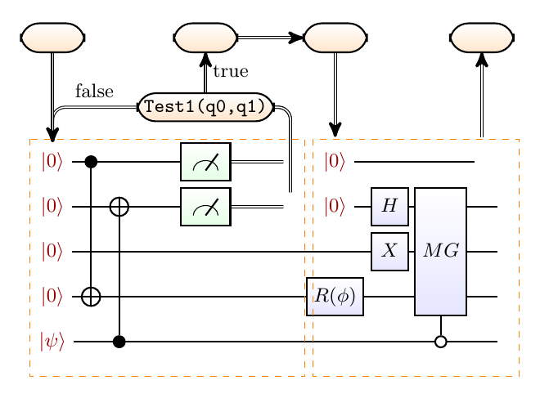
Compilation onto Hardware
let QFT (qs : Qs) =
let n = qs.Length - 1
for i = 0 to n do
let q = qs.[i]
H q
for j = (i + 1) to n do
let theta = 2.0 * Math.PI /
float(1 <<< (j - i + 1))
CRz theta qs.[j] q
for i = 0 to ((n - 1) / 2) do
SWAP qs.[i] qs.[n - i]
let QftOp = compile QFT
let QftOp’ = adjoint QftOp
Microsoft Proprietary

Slide 52
Quantum Computer Architectures Breakout Discovery (Getting quantum systems to compute) Development (Quantum computing software) Deployment (Assessing quantum computers) Jasmine Room, 1pm

