Slide 1
The End of the Post WWII Order
Dave “ Sunny” Sundstrom
HPC Software Products and Strategy
March 2016

Slide 2
The End of the Post WWII Computing Order
Moore’s law

Slide 3
Moore’s Law
45 years
and still counting....
…but we CAN now
see the light at the
end of the tunnel.
The Economist, Double, Double, Toil, and Trouble, March 12th, 2016

Slide 4
The End of the Post WWII Computing Order
Moore’s law isn’t
“The network is the computer”

Slide 5
Memory hierarchies
All logic or computation is done on data in the registers
The caches, no matter how many levels, are not formally “memory”
Caches ONLY exist to more quickly provide data to the registers
The processor does not directly address the cache
SSDs and disks are not directly accessed by the processor
Slow and complex I/O operations are used

Slide 6
The “memory” hierarchy
In all computers there is a hierarchy of “memory” and storage
Level | Amount | Access time (approximate, in processor cycles)
Register | $\text{O}$(2⁶) | 1
L1 cache | $\text{O}$(2¹⁵) | 2
L2 cache | $\text{O}$(2¹⁸) | 10
L3 cache | $\text{O}$(2²²) | 60
Memory | $\text{O}$(2³⁷) | 300
SSDs | $\text{O}$(2³⁹) | 250,000
Disk | $\text{O}$(2⁴¹) | 7,500,000

Slide 7
Memory is an old problem
This result deserves to be noted. It shows in a most striking way where the real difficulty, the main bottleneck, of an automatic very high speed computing device lies: at the memory. Compared to the relative simplicity of CA (cf. the beginning of 11.1 and {15.6}), and to the simplicity of CC and of its “code" (cf. {14.1} and {15.3}), M is somewhat impressive: The requirements formulated in 12.2, which were considerable but by no means fantastic, necessitate a memory M with a capacity of about a quarter million units! Clearly the practicality of a device as is contemplated here depends most critically on the possibility of building such an M, and on the question of how simple such an M can be made to be.
J. von Neumann, First Draft of a Report on the EDVAC, University of Pennsylvania, June 30, 1945.

Slide 8
The End of the Post WWII Computing Order
Moore’s law isn’t
“The interconnect is the computer”
There’s a reason that we started by calling it “data processing”

Slide 9
Computing Operations by Energy Consumption
Quiz
Which requires more energy, computation or communication?
Computation is almost “free” relative to communication (wrt energy)
Operation | Energy (pJ)
64-bit integer operation | 1
64-bit floating-point operation | 20
256 bit on-die SRAM access | 50
256 bit bus transfer (short) | 26
256 bit bus transfer (1/2 die) | 256
Off-die link (efficient) | 500
256 bit bus transfer(across die) | 1,000
DRAM read/write (512 bits) | 16,000
HDD read/write (32k bits) | $\text{O}$(10⁶)
28nm CMOS, DDR3

Slide 10
Data growth
Better decisions, better science, need better (or more) data
The growth of data:
The rate exceeds “Moore’s Law”
>80% of new data sources are unstructured
The proportion of unstructured data is increasing

Slide 11
The End of the Post WWII Computing Order
Moore’s law isn’t
“The interconnect is the computer”
There’s a reason that we started by calling it “data processing”
The middle path

Slide 12
Google DeepMind Challenge
The Nature paper published on 28th January 2016, describes the technical details behind a new approach to computer Go that combines Monte-Carlo tree search with deep neural networks that have been trained by supervised learning, from human expert games, and by reinforcement learning from games of self-play.

Slide 13
The End of the Post WWII Computing Order
Moore’s law isn’t
“The interconnect is the computer”.
There’s a reason that we started by calling it “data processing”.
The middle path
And so………………..

Slide 14
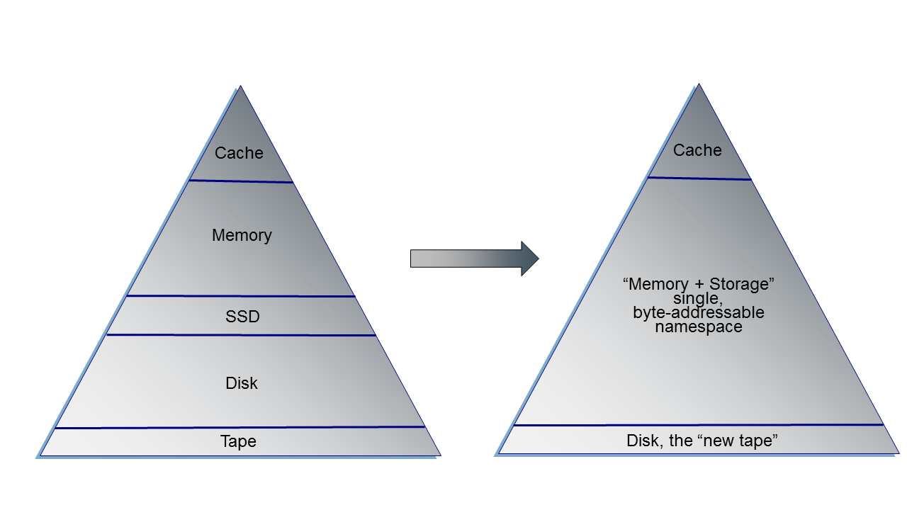
Change the storage hierarchy
Move (semi-)ephemeral file or object stores from disks to a (NVM) processor address space

Slide 15
TheMachine
The largest research program in HP Labs’ history
In essence, it is a new architecture
Predicated on three high-level concepts
VERY large, fabric-attached persistent memory
Use of photonics for data communications
Specialized semi-SoCs as compute entities
See
https://www.youtube.com/watch?v=Gxn5ru7klUQ
https://www.youtube.com/watch?v=QPQ1AheNro8

Slide 16
But before the imposition of the new world order,
a word from our (also my) sponsor….

Slide 17
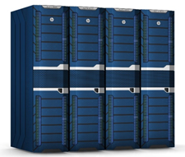
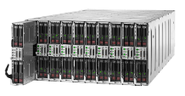
HPE Apollo
From traditional datacenters to highly specialized supercomputing
HPE Apollo 8000
Warm water supercomputing
Extreme Datacenter Scale
Maximum density / performance
Practical water cooling without the risk
HPE Apollo 6000
Air cooled rack scale HPC
Rack Scale Efficiency
Front Serviceable
Purpose Built for data and compute design centers
HPE Apollo 2000
Datacenter scale-out
Familiar Form factor
Small “Bite” sizes (1-4 Nodes)
Configuration flexibility
Management / Workloads / Processors / Accelerators
Notes:
The Apollo family, supports a broad range of HPC deployments, from small, entry configurations in the enterprise, with Apollo 2000, to the most complex Supercomputing applications, with Apollo 8000.
Apollo 8000, is a water cooled supercomputer, which delivers 250 teraflops of compute per rack, with game changing data center efficiency, with a PUE of 1.1. It is ideal, for very complex numerical simulations and mathematical modeling applications, that require massively parallel computing capabilities.
The Apollo 6000, delivers HPC capabilities, for the next level of processing requirements, in mid size and large enterprise, with rack scale efficiencies, in terms of power, cooling and space together, with targeted workload optimization, to enhance performance.
The Apollo 2000, is the ideal Enterprise Bridge, for customers who are embarking on the scale out journey for the enterprise, and need a solution, for small deployments of HPC, as well as general purpose workloads, in a non-disruptive manner.

Slide 18
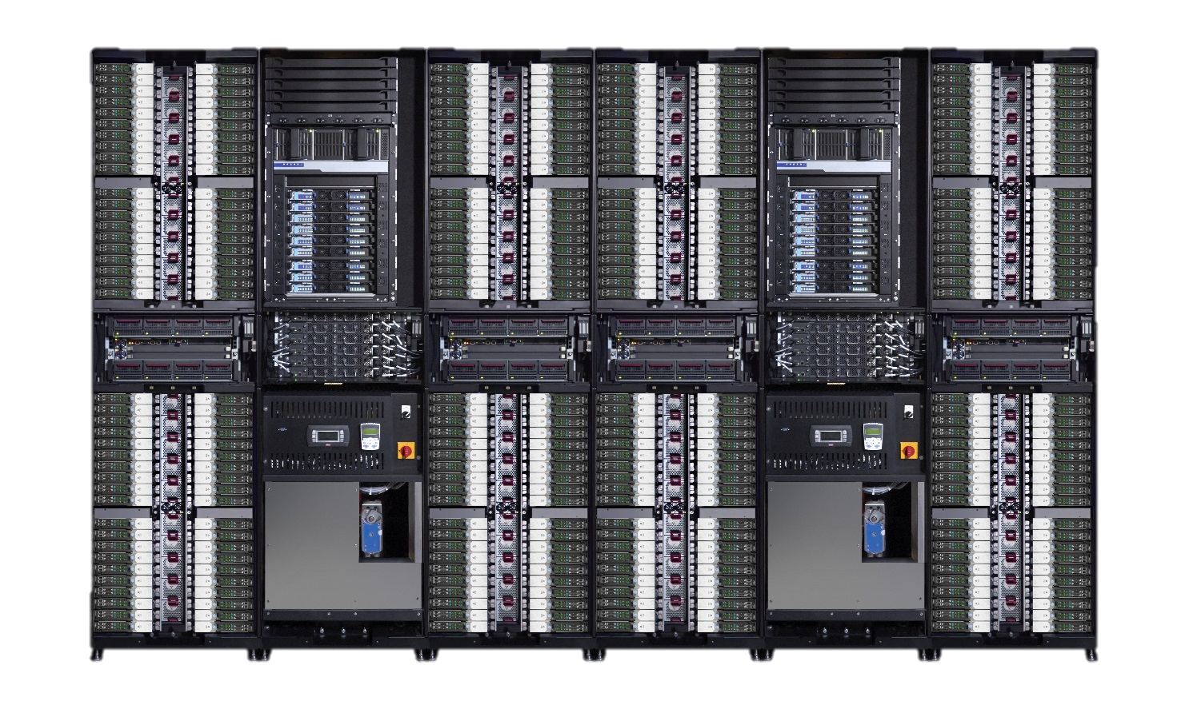
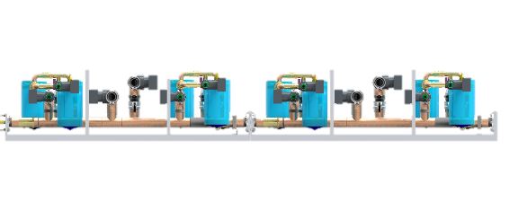
HPE Apollo 8000 System Technologies
Intelligent Cooling Distribution Unit
320 KW power capacity
Integrated controls with active-active failover
Dry-disconnect servers
100% water cooled components
Designed for serviceability
Management infrastructure
HPE iLO4
CMU, IPMI 2.0 and DCMI 1.0
Rack-level Advanced Power Manager
Warm water
Closed secondary loop in CDU
Isolated and open facility loop
Power infrastructure
Up to 80kW per rack
Four 30A 3-phase 380-480VAC
Raised Floor
Under the floor plumbing kit
Notes:
Let me walk you through some of the technologies in this system. First, dry-disconnect server trays provide liquid cooling without breaking any water connections. Those trays also make this system easy to service without any worries. Facility water is isolated from the water inside of the rack.
A starting configuration has one IT rack holding up to 144 servers, and one Intelligent Cooling Distribution Unit (iCDU) Rack that supports up to 4 IT racks. The iCDU has 320kW capacity so you can cool higher-performing technologies including higher-bin processors and accelerators.
In essence, this is a converged system, with built-in management infrastructure. The Apollo 8000 System Manager aggregates and consolidates management for quick and easy insight and management for all the system components.

Slide 19
Who’s #1?
Who has the most systems in the most recent HPC Top 500 List?
with 155 of 500 systems, the most of any single vendor, almost 1/3 of the total! WE’RE #1!
But……….
……….we have not provided complete HPC solutions (hardware and software) and have been dependent on partners for delivery.

Slide 20
HPE HPC Software Environment Integrated software and management solutions for HPC applications
Management
Applications
Development | Compilers, debuggers, profilers, libraries, latest GPU/FPGA development kits
Libraries/runtimes | MPI, math, science, fabric, graphics, etc.
Workload management | Schedulers, meta-schedulers, and orchestrators tightly integrated through CMU connectors, open source and commercial
Resource management | Lustre w OpenZFS backend, storage management, cloud interfaces, burst buffer management,……
Cluster management | Insight CMU, Redfish, REST API, limit-free architecture
OS | RHEL, CentOS , SLES includes drivers
Servers/nodes | iLO, BIOS, other firmware and BMCs
Exo-server | iLO, Apollo Platform Manager (APM)
Exo-system | OneView, Apollo 8000 System Manager, facility and grid interfaces….
Management is not a layer but a top-to-bottom set of fully integrated components
Management extends “above” the server layer
New components and interfaces are being added constantly
Monitoring

Slide 21
The Brave New World at
Short-term
Complete, market focused HPC solutions
Ease-of-use
Complete management including exo-system
HPC community development and contribution
Solutions for the Big Data/HPC mashup
Longer term
A new computing architecture, evidenced in TheMachine

Slide 22
Thank you
sunny.sundstrom@hpe.com

Slide 23
The End of the Post-WWII Order
“Not only the post–World War II order but also the post–Cold War order are rapidly crumbling. ……………
A radical integration of the world through high-speed information networks and modern logistics is redrawing the global geostrategic map……………..
Digitalization will destroy the top-down management system that emerged from the nineteenth century……
Power and influence will flow to those who can move quickly to exploit new sorts of network behavior. The system will require an open, democratic code of values that allows the greatest possible flow of objective information.”
John Kornblum
Senior counselor at Noerr LLP and former U.S. ambassador to Germany
May 2015

Slide 24
HPC does, indeed, matter

Slide 25
.
Moore’s law isn’t
The network is the computer
∑ Lx$ ≠
Nothing is as powerful as an idea whose time has come……and some ideas’ time take……time
The middle path

Slide 26
The End of the Post WWII Computing Order
Moore’s law isn’t
“The network is the computer”.
There’s a reason that we started by calling it “data processing”.
The middle path

