Slide 1
The REX Neo:
A New Processor Architecture for Exascale and Beyond
Thomas Sohmers
March 24th 2016
SOS20
Notes:
Learn more at: rexcomputing.com
Or contact thomas@rexcomputing.com

Slide 2
Team: Founders
Thomas Sohmers, Founder and CEO. Worked at the MIT Institute for Soldier Nanotechnologies for 3 years as both an end user of HPC systems, and later transitioned into designing and building them at the lab. This experience led to starting REX Computing in 2013 as a recipient of Peter Thiel’s “20 Under 20” Fellowship, where he leads architectural design and operations. Thomas has been featured on Forbes’ 30 under 30 list and is a project lead for the Open Compute Project HPC Group.
Paul Sebexen, CTO.
Paul started programming as a child, and studied CS at Georgia Tech. He has worked in fields including structural biology, theoretical ecology, and nanofabrication. Paul was part of the 2012 class of Thiel Fellows, where he founded a synthetic biology startup and worked at Lawrence Berkeley National lab for 18 months. He later joined Thomas in starting REX, where he contributes an extensive knowledge of low level software and tool development.

Slide 3
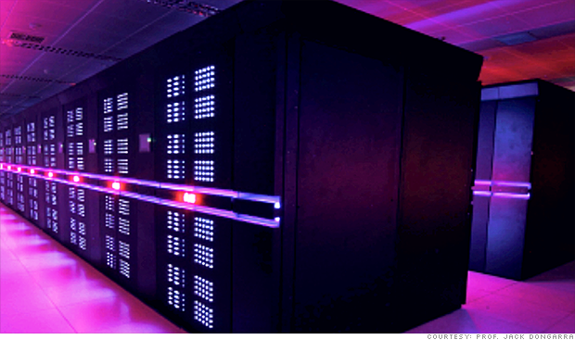
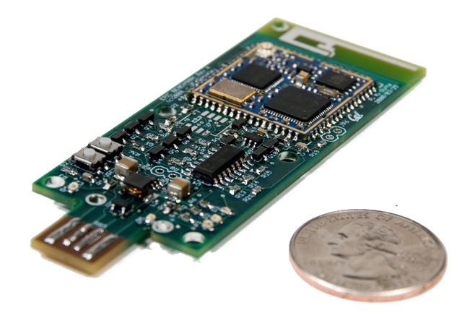
What’s so big about Exascale?
10¹⁸ FLOPs
How have we always picked HPC systems?
Applications are picked first, and hardware is designed to fit those.
Most cases you have a hard set power/area/cost budget, but will try to get the best bang for your buck.
For the majority of large problems, the goal is to fully utilize the entire system.

Slide 4
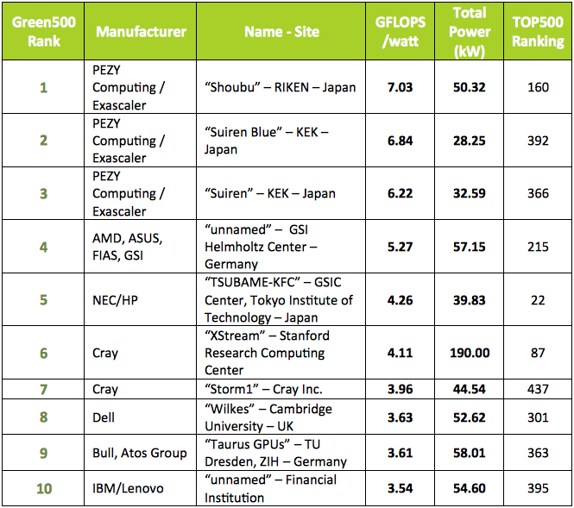
Current state of energy efficiency
At single chip level (not including system overhead)
Intel Xeon E5 | Intel Xeon Phi KNL | NVIDIA K80
1344 | ~3000 | 2,910
4.97 | ~10 | 9.7
Double-precision GFLOPS
Double-precision GFLOPS/W

Slide 5
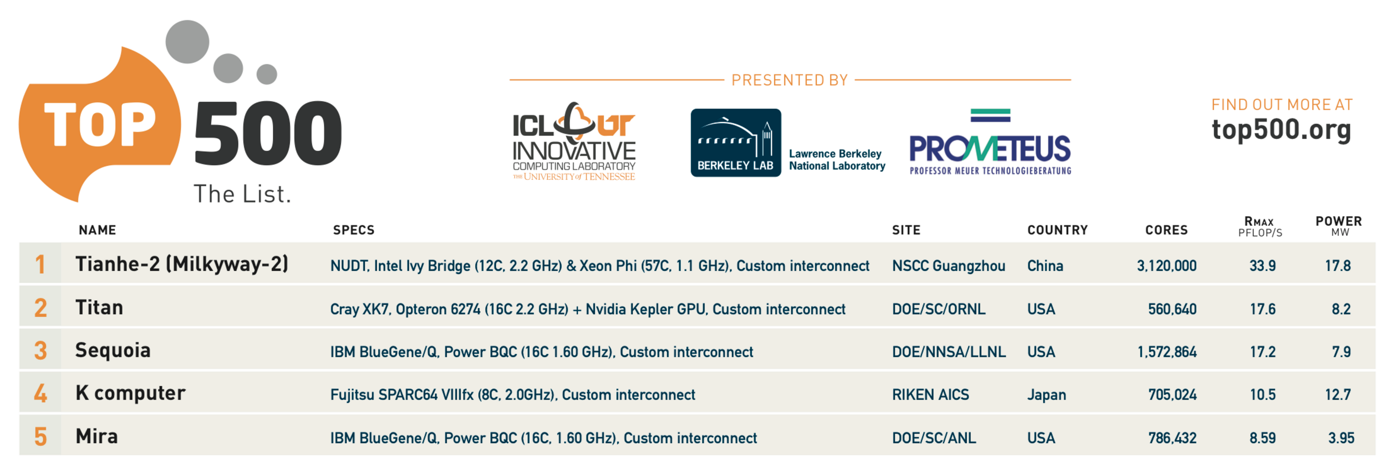
Current state of energy efficiency
At single chip level (not including system overhead)
Intel Xeon E5 | Intel Xeon Phi KNL | NVIDIA K80
1344 | ~3000 | 2,910
4.97 | ~10 | 9.7
Double-precision GFLOPS
Double-precision GFLOPS/W
TOP500 list
GFLOPs/w
1.9
2.1
2.1
0.8
2.1

Slide 6
Existing roadmaps will not get us to Exascale
50 GFLOPs/watt Target

Slide 7
REX Computing is a new approach to efficient computing, redefining how processors are designed and where computing occurs.
REX Computing Neo

Slide 8
Current processors were designed for an old paradigm
Cost of a Double Precision Floating Point Operation
Sandy Bridge era
4200pJ
100pJ
60% is used by the unnecessary on chip cache hierarchy
Data movement now requires over 40x more energy than an actual calculation.

Slide 9
A short history of caches
“You can’t fake memory bandwidth that isn’t there” –Seymour Cray
Caches are great…
Hide latency due to slow main memory
CDC 6600 (1964) with instruction stack through the initial Motorola 68k (1982) instruction caches. It only started to get bad when chip designers had a bunch of “free” transistors.
Except kills power efficiency when implementing virtual memory
IBM System 360 Model 67 (1967) was the first to implement Virtual Memory with what we would now call a MMU (at that point a “Dynamic Translation Box”)
Additional logic for TLBs and other logic on a modern chip uses 30%-50% of the die area.
Virtual Memory translation and paging are two of the worst decisions in computing history
Makes things a bit easier for a programmer when you assume you have bad compilers, but at significant hardware (power, area, and latency) cost.

Slide 10
A short history of caches cont.
Chip designers got lazy with VLSI
Intel 286 (1982) was one of the first commercial chips to implement memory protection, and expanded upon the memory segmentation of the 8086.
Intel 386 (1986) was the first to implement an external cache (16 to 64K), but it was not replicating anything higher up in the hierarchy.
The 486 (1989) was the first to implement an 8K on die cache.
The Pentium and Pentium Pro continued this trend, implementing a managed cache hierarchy followed by a second level of cache.
Introduction of hardware managed caching is what I consider “The beginning of the end”, in which additional hardware complexity was acceptable due to not caring how many transistors were used, as they were get faster, lower power, and cheaper every year.
This does not work well once the power wall (End of Dennard Scaling) was reached, and is starting to completely break down with the end of Moore’s law approaching.

Slide 11
Introducing the REX Neo Architecture
REX Computing Neo
Neo is complete computing solution designed with the processing realities of the 21st century:
256 core MIMD Compute Chip
2D Mesh Network on Chip
Software managed memory system
Global Flat Address Space

Slide 12
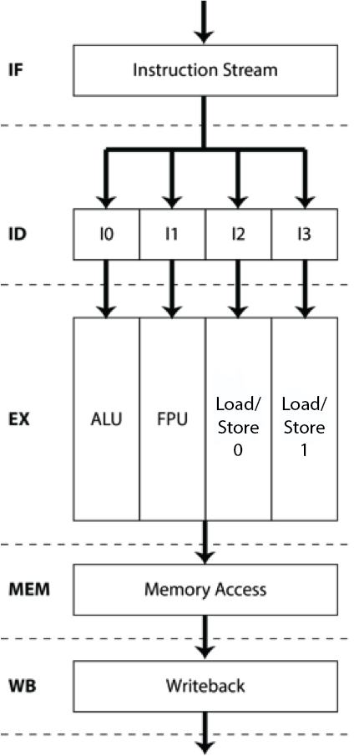
The Neo core: Simple, low-power, and highly scalable.
Custom Quad-issue VLIW packed into 64 bits
98 RISC-like instructions
Integer: 64-bit ALU
Floating Point: 64-bit IEEE 754-2008 FPU; supports dual issue of 32-bit operations
Two Load / Store Units
Segmented register files.
Sixteen entry 64 bit General Purpose RF
Sixteen Entry 64 bit Floating Point RF
All memory latencies on chip (and across interconnected identical chips) are guaranteed
Large software-managed scratchpad
128 KBytes of local memory (SRAM) per core
Can be a mix of instructions and data
Flat Global Address Space across all cores in one or multiple chips
Removing now redundant hardware caching complexity allows more memory, increases speed, and reduces power consumption

Slide 13
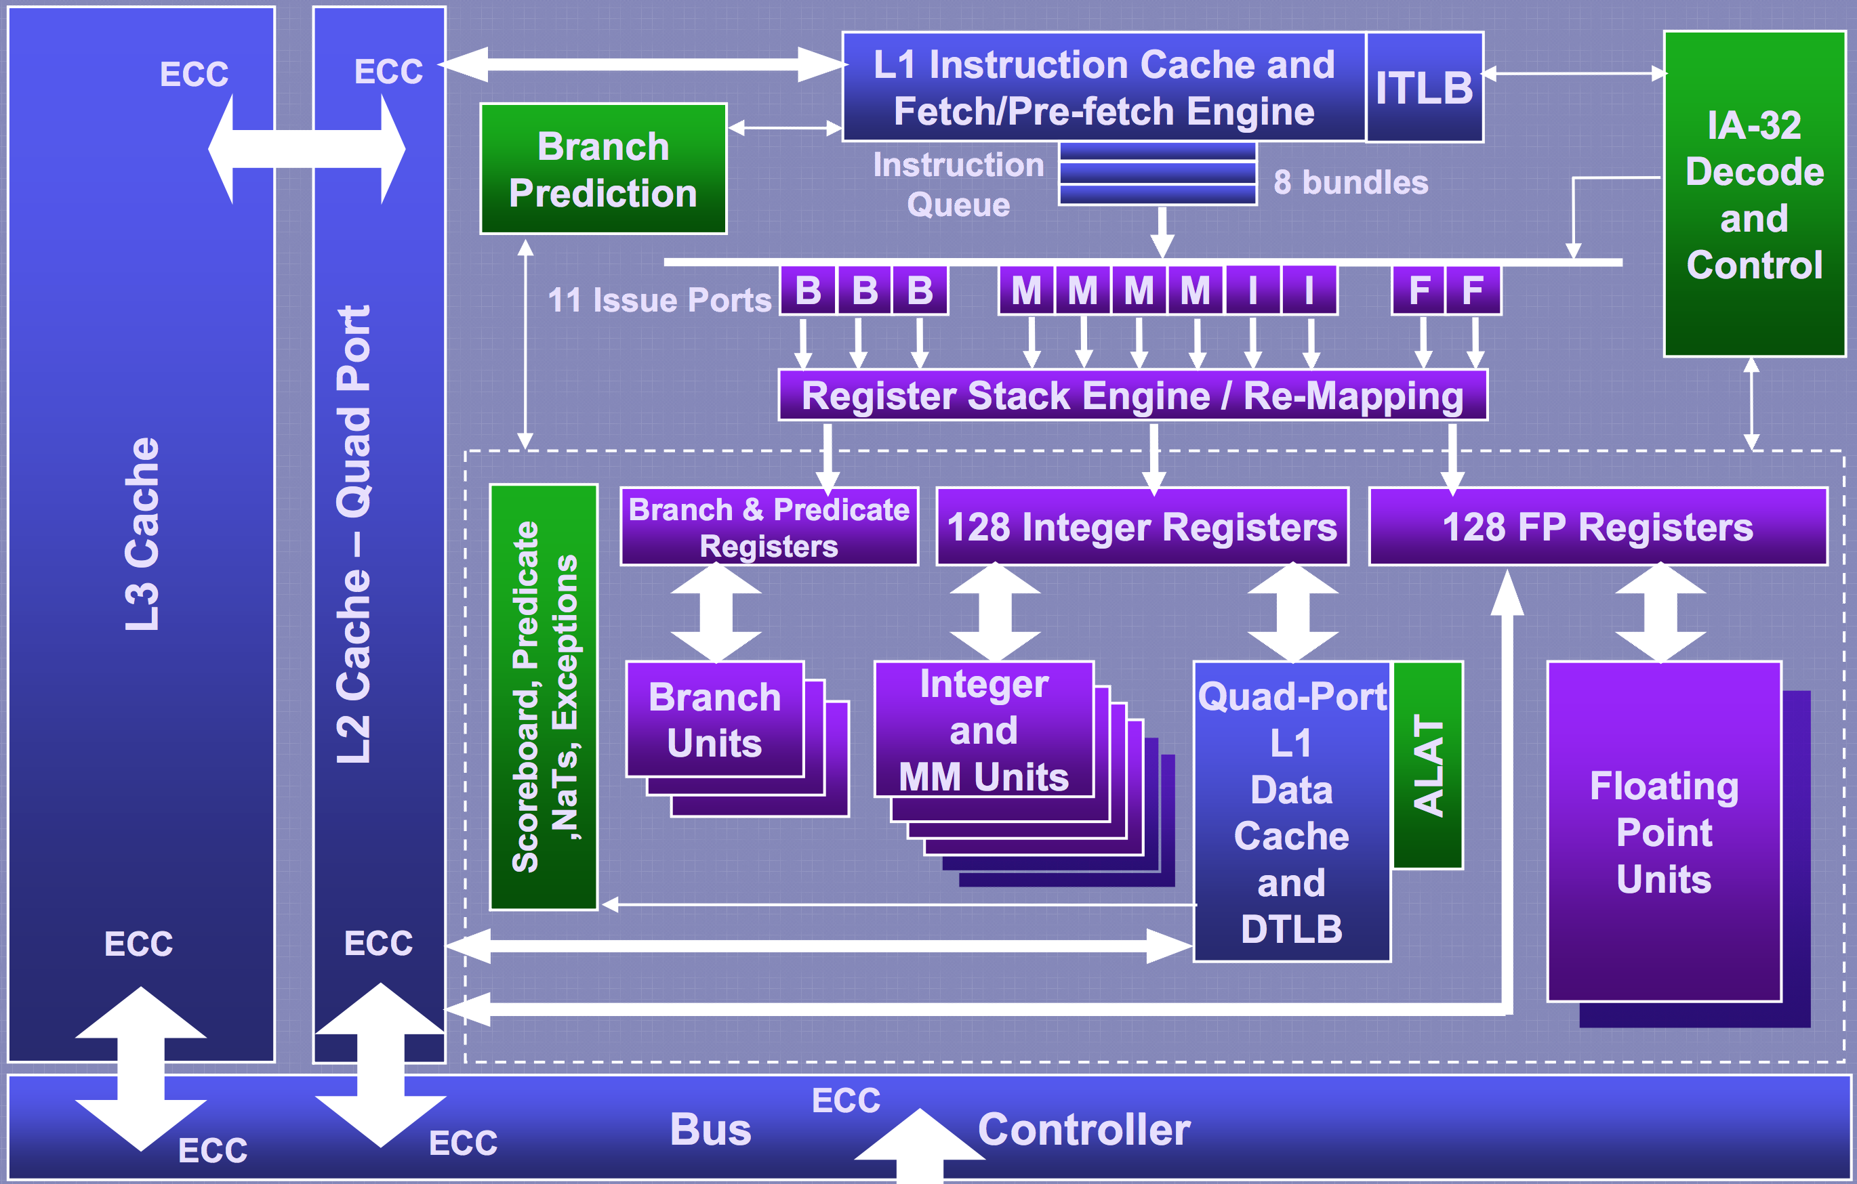
VLIW?! Scratchpad?! That’s madness!
Q: VLIW? Isn’t that a proven failure by Intel with Itanium?
Not quite…
All of these things add ridiculous complexity and make it near impossible
to statically schedule and allocate resources!

Slide 14
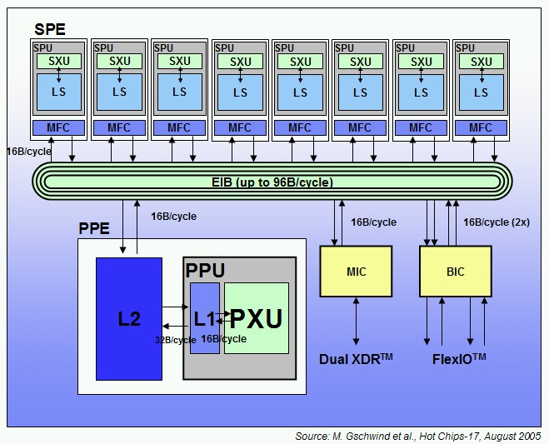
VLIW?! Scratchpad?! That’s madness!
Q: VLIW? Isn’t that a proven failure by Intel with Itanium?
Not quite…
Q: IBM Cell had scratchpad memory, and wasn’t it basically impossible to program?
Scratchpads require either a good programmer, or in our case, a very good compiler. As for Cell, many completely blamed the scratchpad memory, but in reality it was just bad architectural design.

Slide 15
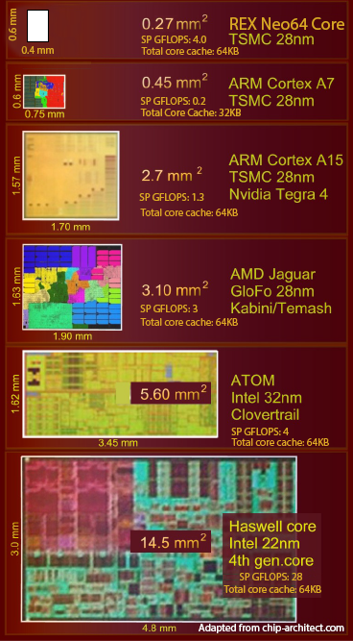
VLIW?! Scratchpad?! That’s madness!
Q: VLIW? Isn’t that a proven failure by Intel with Itanium?
Not quite…
Q: IBM Cell had scratchpad memory, and wasn’t it basically impossible to program?
Scratchpads require either a good programmer, or in our case, a very good compiler. As for Cell, many completely blamed the scratchpad memory, but in reality it was just bad architectural design.
Q: Simple cores can’t be used in HPC! You can never get the performance needed in a small package!
Well that’s not a question, but…
Even at a process disadvantage (Neo at 28nm vs Intel Haswell at 22nm), Neo has a…
7.5x higher computational capacity
per mm^2 than Intel Haswell!

Slide 16
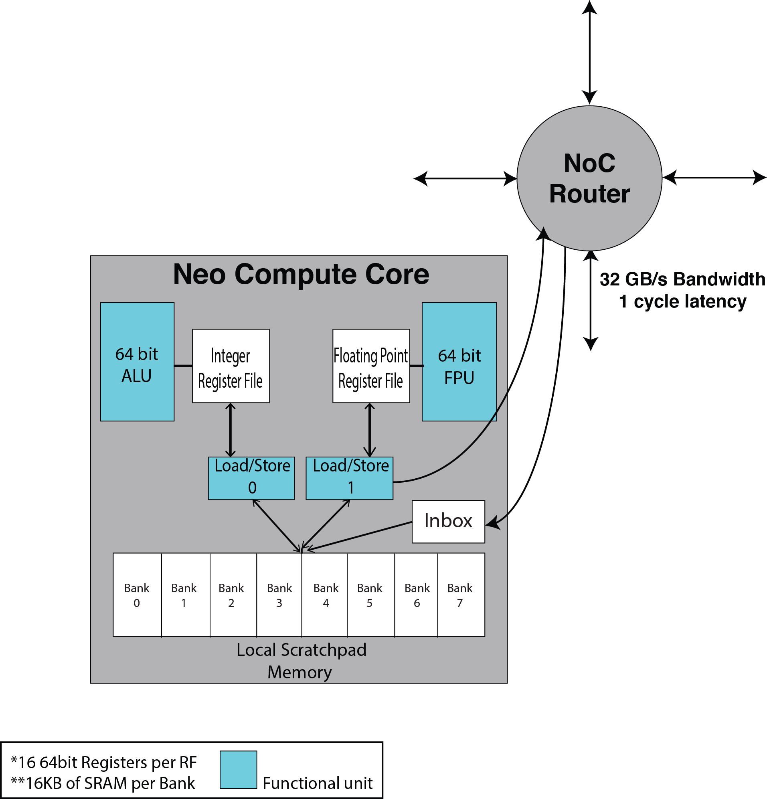
The Neo Compute Core
Quad-issue VLIW
Can achieve sustained theoretical peak performance for all functional units
Local Scratchpad Memory
Less than 0.3 mm² in TSMC 28nm

Slide 17
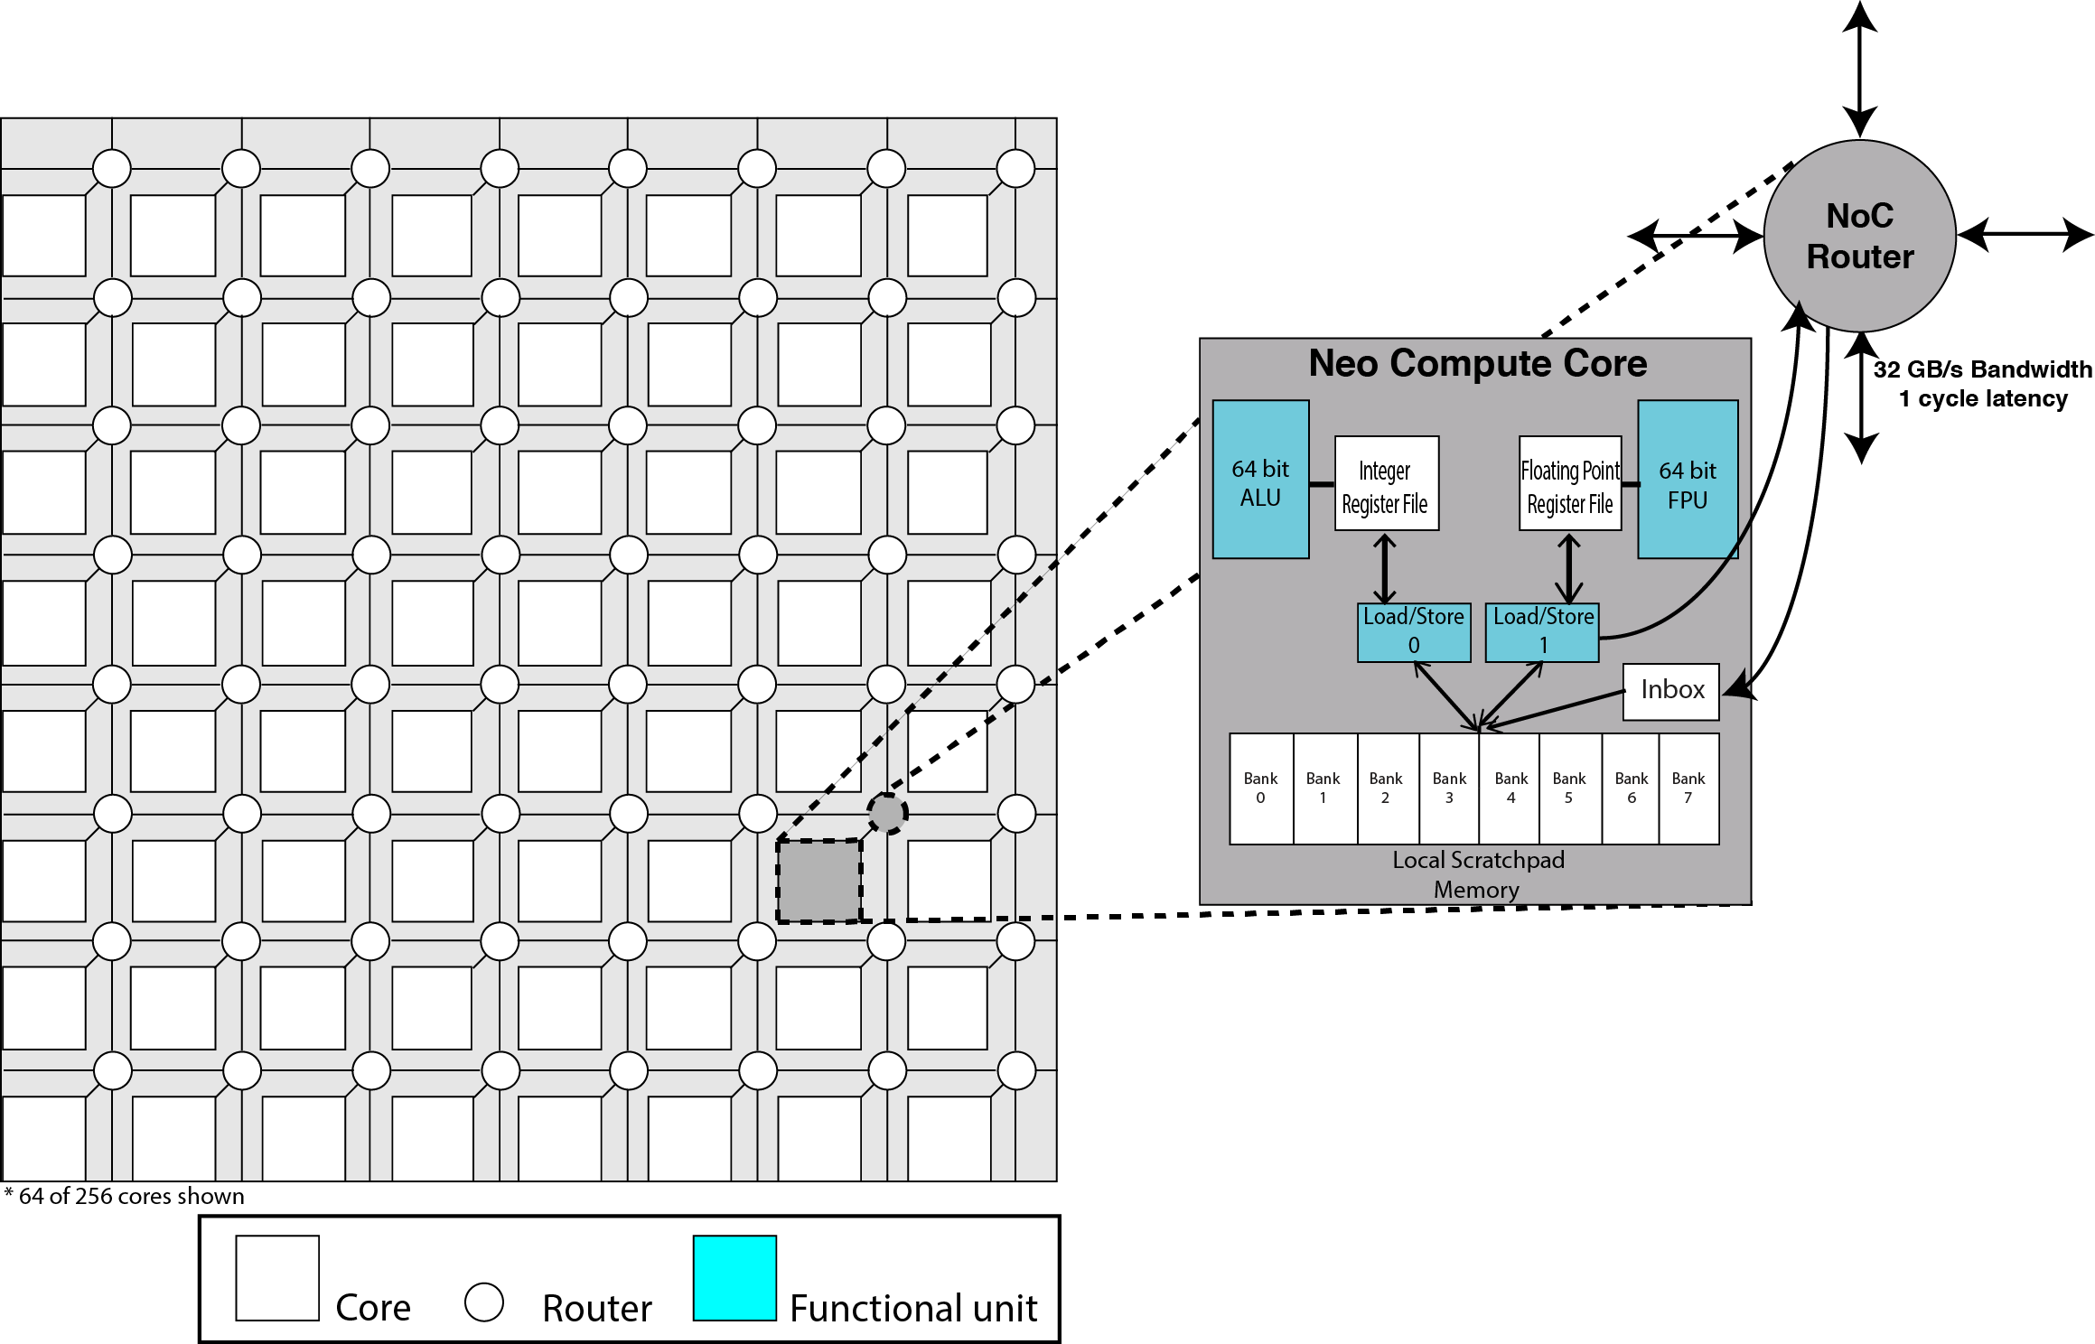
The Neo Network on Chip Maximizes Scalability
2D-Mesh Network on Chip
Statically Routed & Deadlock Free
Balanced Bandwidth for Peak Compute Throughput
Global Flat Address Space

Slide 18
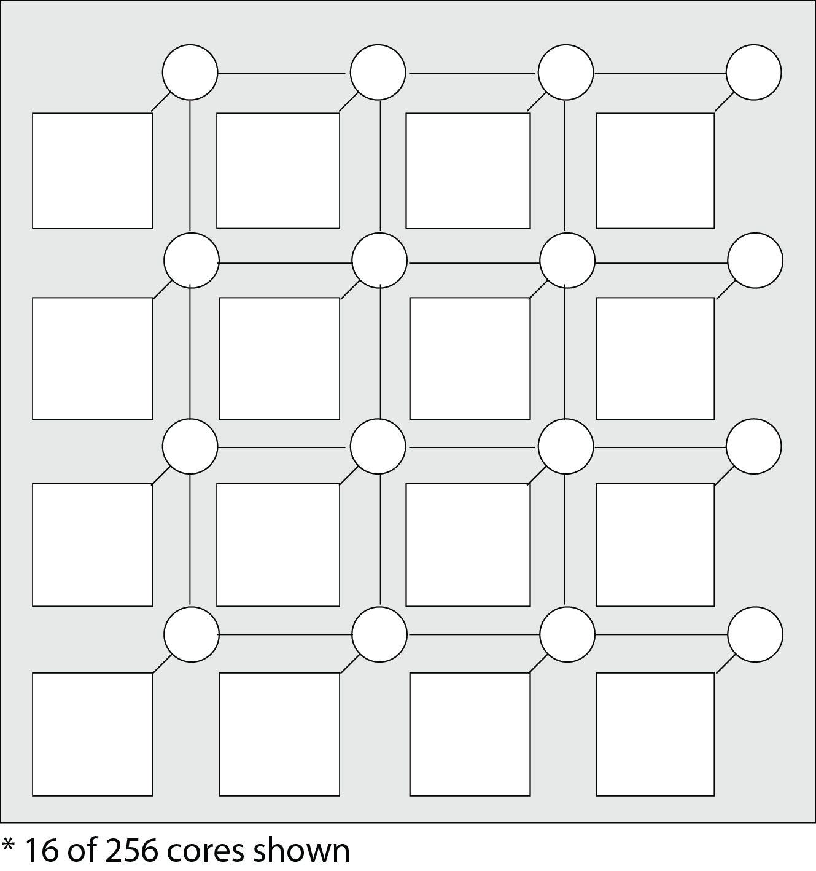
Simple latency guaranteed load/store architecture for all memory accesses
0-128K
128-256K
256-384K
384-512K
896-
1024K
512-640K
640-768K
768-896K
1024-
1152K
1152-
1280K
1280-
1408K
1408-
1536K
1536-
1664K
1664-
1792K
1792-
1920K
1920-
2048K

Slide 19
The Neo Network on Chip seamlessly scales with the address space
0-128K
128-256K
256-384K
384-512K
512-640K
640-768K
768-896K
896-
1024K
1024-
1152K
1152-
1280K
1280-
1408K
1408-
1536K
1536-
1664K
1664-
1792K
1792-
1920K
1920-
2048K
2048-
2176K
2176-
2304K
2304-
2432K
2432-
2560K
2560-
2688K
2688-
2816K
2816-
2944K
2944-
3072K
3072-
3200K
3200-
3328K
3328-
3456K
3456-
3584K
3584-
3712K
3712-
3840K
3840-
3986K
3968-
4096K
4096-
4224K
4224-
4352K
4352-
4480K
4480-
4608K
4608-
4736K
4736-
4864K
4864-
4992K
4992-
5120K
5120-
5248K
5248-
5376K
5376-
5504K
5504-
5632
5632-
5760K
5760-
5888K
5888-
6016K
6016-
6144K
6144-
6272K
6272-
6400K
6400-
6528K
6528-
6656K
6656-
6784K
6784-
6912K
6912-
7040K
7040-
7168K
7168-
7296K
7296-
7424K
7424-
7552K
7552-
7680K
7680-
7808K
7808-
7936K
7936-
8064K
8064-
8192K

Slide 20
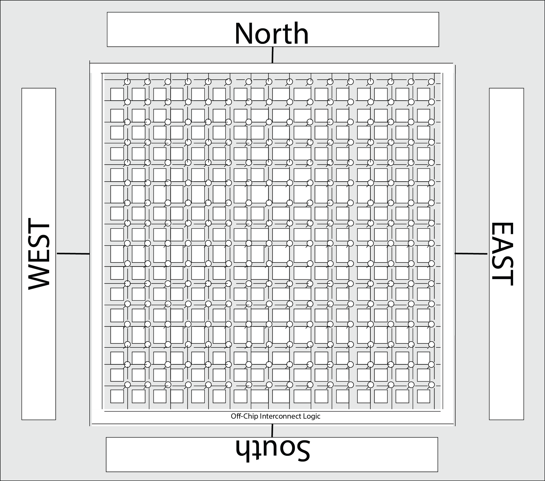
The Neo chip balances compute with memory and I/O.
Software-managed memory hierarchy:
128K local scratchpad per core (32 megabytes L1 equivalent for 256 core chip)
Any core can access any other core’s (on chip or attached chips) memory
Strict determinism enforced for all work done on one or more Neo chips in a system.
Flexible, manycore MIMD design supports many programming models, including Actor, CSP PGAS, SHMEM, and Systolic Array/Dataflow. Each core is fully independent and can operate together or segmented.
Four high speed interconnects give aggregate 512GB/external bandwidth
Can be used to connect other Neo chips to form larger grids, or to eternal memory (DDR4, HMC, HBM) or I/O (Infiniband, Ethernet)

Slide 21
Familiar software tools and runtime environment.
Toolchain
LLVM based toolchain leverages the open source community while implementing novel scheduling & resource allocation techniques.
Graph theoretic techniques for stack and heap management
Original compiler work done under DARPA grant for advanced compilation and portability techniques
The first “smart” compiler that actually has enough information to make good decisions
Deterministic architectural design allows for a a first of its kind “smart” compiler that seamlessly handles scratchpad management
Can be assisted through runtime profiling techniques
Support for numerous LLVM frontends
Currently support C, C++, and Objective-C through the Clang front end
Ability to support all LLVM frontends
Runtime library and profiler tools
Runtime feedback is given back to compiler to make optimizations that could not be determined statically
Can better inform the developer to make similar decisions in the future

Slide 22
Neo significantly outperforms its competition.
Chip | GFLOPs (FP32) | GFLOPs (FP64) | Watt | GFLOPs/W (64) | Price
REX Neo (256 core) (2017) | 1024 | 512 | 8 | 64 | TBD
Intel Xeon E5 (20 core)(2016) | 1344 | 672 | 135 | 4.97 | $3,500
Xeon Phi 7120 (61 core) (2014) | 1900 | 1200 | 300 | 4 | $4,235
Xeon Phi Knights Landing (72 cores) (2016) | 4500 | 3000 | 250 | 12 | TBD
NVIDIA K80 (2015) | 8740 | 2910 | 300 | 9.7 | $5,000
NVIDIA G100 (2016) | 12000 | 4000 | 300 | 13.33 | $5,000
Adapteva Epiphany IV | 102 | N/A | 2 | N/A | $750
Kalray MPPA-256 | 230 | 43 | 11 | 3.9 | $2,000
Notes:
Intel Xeon E5 2698v4

Slide 23
Neo Development Tools and Evaluation Kit
First Test Chip (“Gen 0”) Tapeout in May 2016:
Our first test chips built on a TSMC 28nm process feature:
16 fully featured REX Neo cores with 64KB of scratchpad per core
Two 120 Gigabit/s chip-to-chip interfaces
Multi-chip module (2.5D) integration
Neo Evaluation and Development Kits available in Fall 2016:
Select partners will be eligible to purchase or lease development units, and have access to the full Neo development tools and access to the REX support team
Early Access Tools (Available Today):
Neo ISA simulator
Neo compute core FPGA implementation
Cycle-accurate Neo chip simulator
QEMU Neo full-system virtualization
REX Neo EVM1 ($25,000)
Four Neo “Gen 0” test chips
Achronix HD1000 FPGA
Fully stand alone development system, includes everything needed to operate
Includes development support
REX Neo EVM2 ($10,000)
Two Neo “Gen 0” test chips
Xilinx Zynq FPGA (limited bandwidth to test chips)
Requires Host PC (not included)
Includes development support

Slide 24
The 256-core Neo Chip: Full production tapeout in mid 2017
The Neo Compute Chip (1GHz, 256 core, 128k scratchpad per core, TSMC 16nm):
8 Watt TDP
256 Integer Operations per Second
512 GFLOPs (IEEE Double Precision)
64 GFLOPs/Watt
1024 GFLOPs (IEEE Single Precision)
128 GFLOPs/Watt
32GB/s core to core bandwidth; 1 cycle per hop through static Network on Chip
Balanced off-chip bandwidth:
64GB/s per direction, per interface.
512 GB/s aggregate chip-to-chip bandwidth
Optional adapter (integrated in package or on PCB) allow for interfacing with other chips through the Neo custom SerDes.
Planned support for DDR4, HMC, HBM, Infiniband, Ethernet, and other memory and interconnect technologies

Slide 25
7nm
200 GFLOPs/watt
10nm
150 GFLOPs/watt
16nm
64 GFLOPs/watt
28nm
40 GFLOPs/watt
16nm
85 GFLOPs/watt
10nm
22/14nm
14nm
7nm

Slide 26
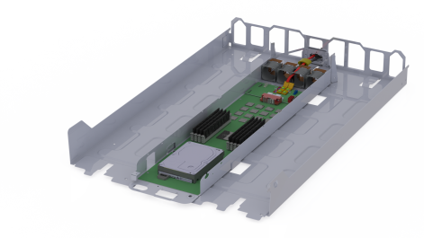
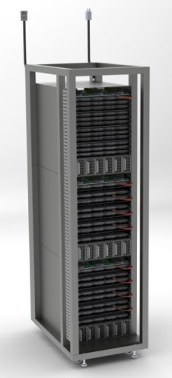
(A very conservative) 1st Generation Neo Rack
One Neo Node
Six nodes in 1U
16 (256 core) Neo chips
4096 cores total
256 GB of DRAM memory
8 DP TFLOPS
150 Watts
One Neo Rack
90 Neo nodes (Six nodes per U)
1,440 Neo processors
368,640 cores
23 TB of DRAM memory
720 DP TFLOPS
15.0 Kilowatts
53 GFLOPS/Watt (DP) Node level
48 GFLOPs/Watt Rack level

Slide 27
REX Neo: Evolving to exascale in early 2020s.
Projected Neo evolution:
 |  |  |  | Racks | PFLOPS | Power (MW) | GFLOPS/W (System Level)
 | REX Neo (3rd Gen) (circa 2020) |  |  | 250 | 1000 | 10 | 80
 | REX Neo (2nd Gen) (2018) |  |  | 350 | 500 | 10 | 50
 | REX Neo (2017) |  |  | 10 | 7.2 | 0.175 | 40
The first practical exascale solution.
250 Neo racks
8+ Petabytes of RAM
Power budget of 10-15MW

Slide 28
The REX Neo:
A New Processor Architecture for Exascale and Beyond
Thomas Sohmers
March 24th 2016
SOS20
Notes:
Learn more at: rexcomputing.com
Or contact thomas@rexcomputing.com

