Slide 1

The ECMWF
forecast model
and its preparation
for the future
Peter Bauer

Slide 2
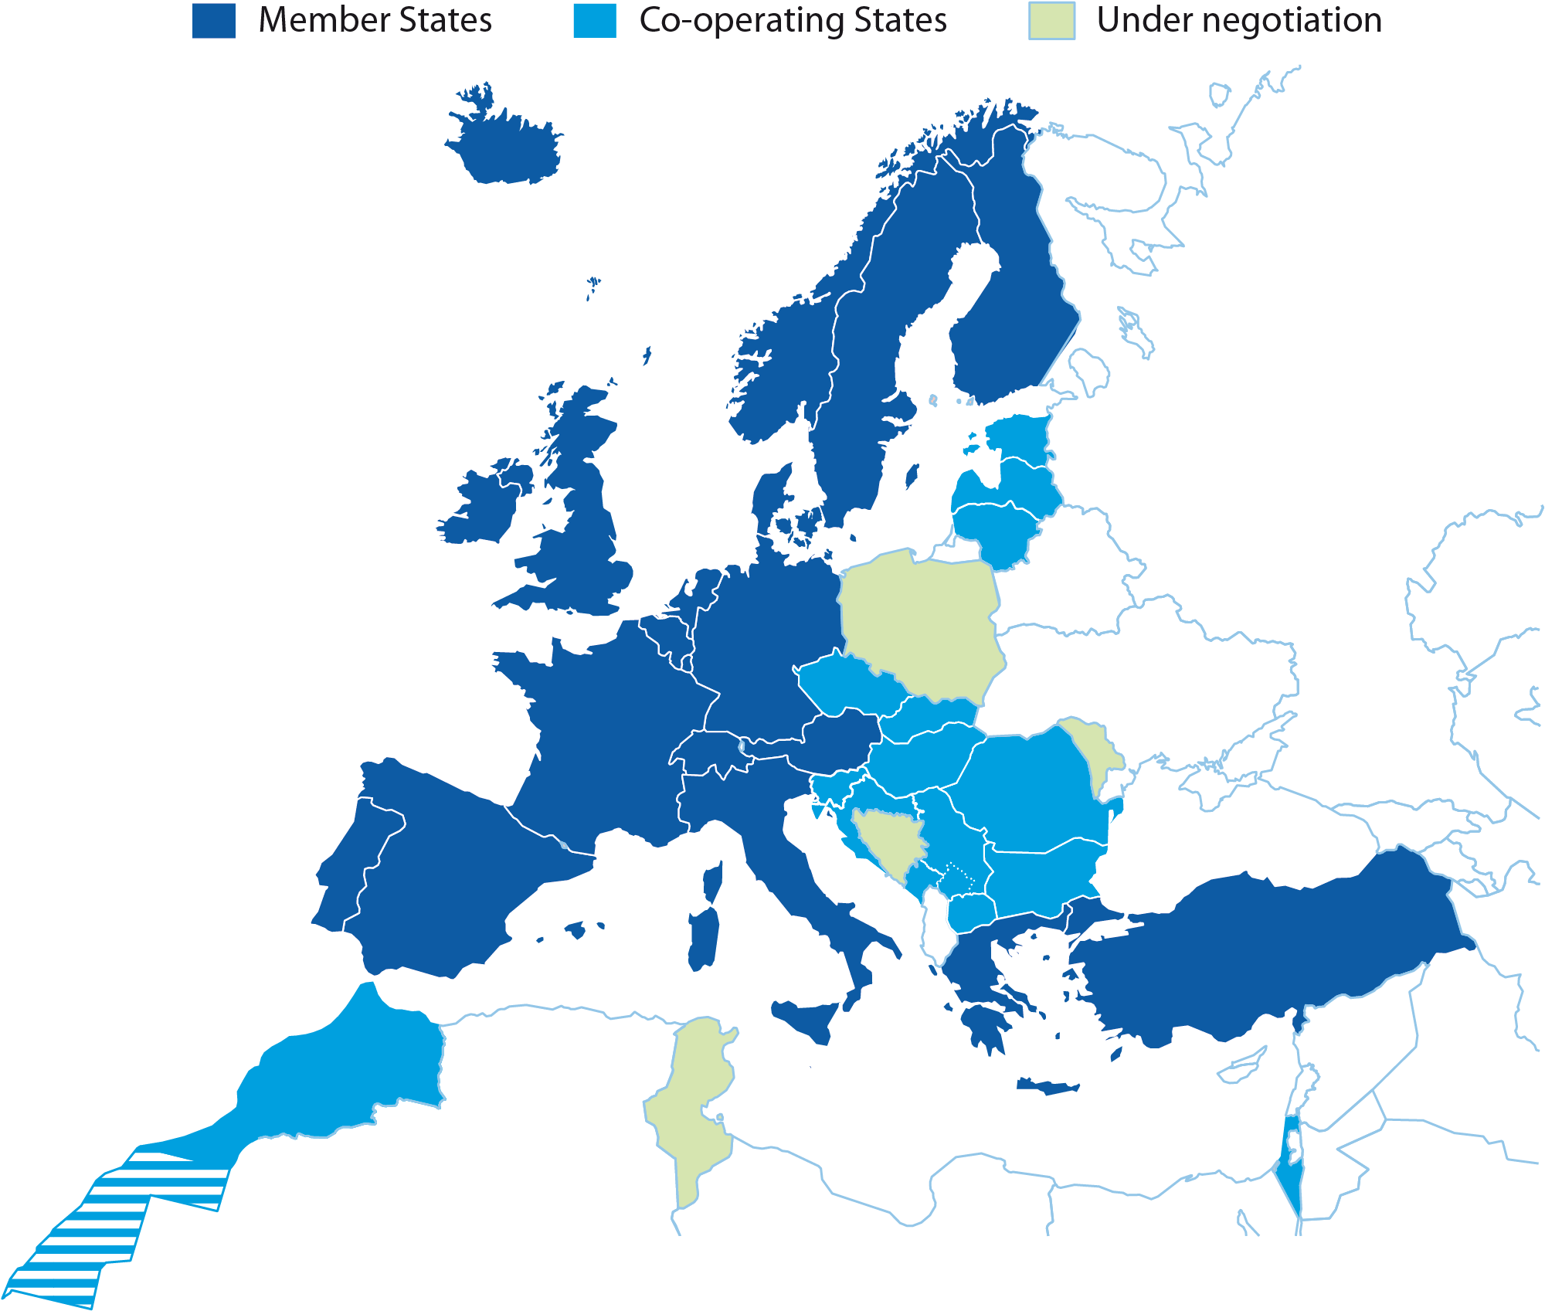
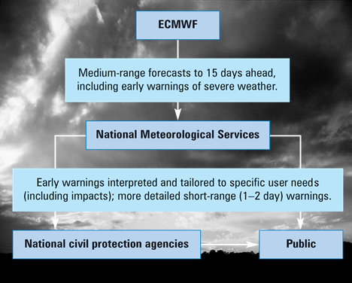
European Centre for Medium-Range Weather Forecasts
Independent
intergovernmental organisation
established in 1975
with
19 Member States
15 Co-operating States
Notes:
For 2011:
Age of ECMWF: 36 years
Employees: 227
Supported by: 34 States
Budget: £43 million per annum
Contributions by Member States
and Co-operating States £39.8 million per annum

Slide 3
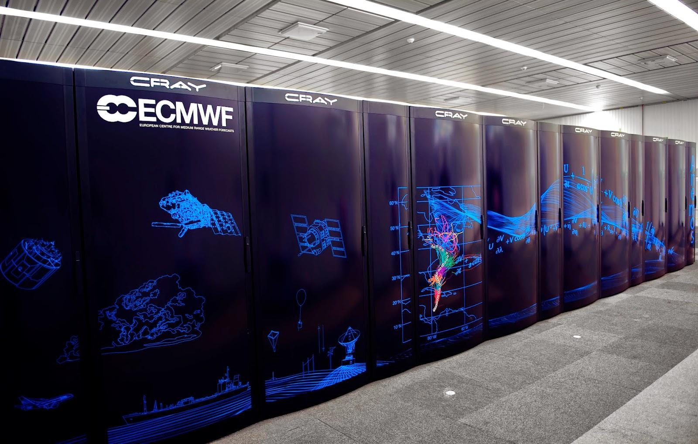
ECMWF HPC
 | Phase 1 (Ivybridge) – 2014-2016 | Phase 2 (Broadwell) – 2016-2020
CPU | 24 cores (2 x 12 core) @ 2.7GHz | 36 cores (2 x 18 core) @ 2.1 GHz
Memory/Node | 64 Gb (1866 MHz DDR3) | 128Gb (2400 MHz DDR4)
Memory/Core | 2.6 Gb | 3.5Gb (+35% cf Phase 1)
Parallel Nodes (per cluster) | 3,400 | 3,513 (+3% cf Phase 1)
Total Cores (per cluster) | 84,096 | 130,212 (+55% cf Phase 1)
Tf sustained (both clusters) | 200 | 320 (+60% cf Phase 1)

Slide 4



ECMWF HPC vs others
NOAA:
  Current: 1.8 petaflops, plus
  New: 2 x 12 cabinets of Cray (Sandy Bridge & Haswell processors), 100,000 cores ≈ 4 petaflops
  → 5.8 petaflops
Met Office:
  Current: 2 x 17 cabinets of Cray (Haswell & Broadwell), 220,000 cores ≈ 6 petaflops
  New: 33 cabinets of next generation Cray (Broadwell) in 2017,
  → 20 petaflops
ECMWF
  2 x 19 cabinets of Cray (Ivy Bridge), 168,000 cores ≈ 3.5 petaflops
  New: 2 x 19 2/3 cabinets of Cray (Broadwell), 260,000 cores
  → 8.5 petaflops
Now: Met Office > NOAA > ECMWF
Mid 2016: ECMWF > NOAA + Met Office
2017: Met Office > NOAA + ECMWF

Slide 5
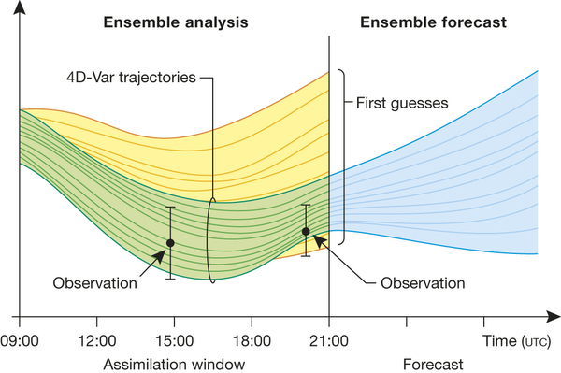
The ECMWF Integrated Forecasting System (IFS)
From initialization to prediction

Slide 6
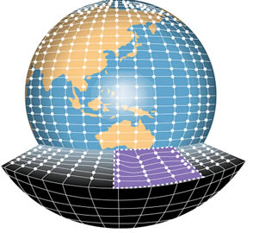
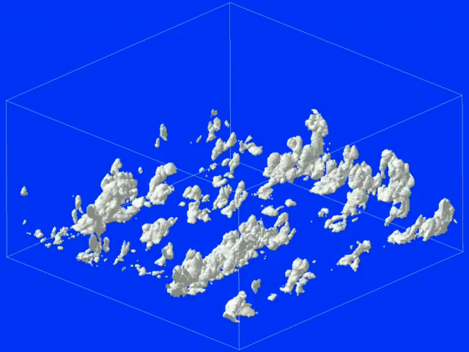
Atmosphere models
No parameterization
(Partial) turbulence parameterization
Turbulence, boundary layer & cloud parameterization
All processes parameterized
Direct Numerical
Simulation
Large Eddy
model
Weather
model
Climate
model
[Courtesy Pier Siebesma]

Slide 7
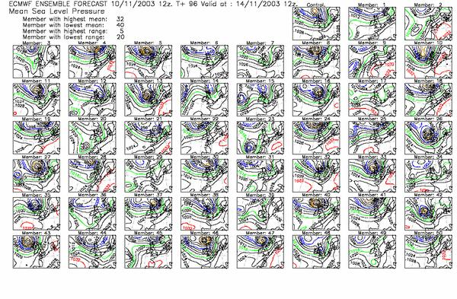
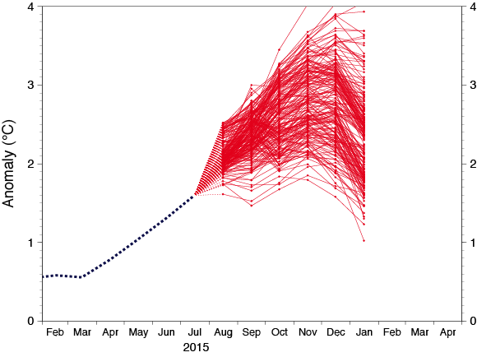
The ECMWF Integrated Forecasting System (IFS)
← 2x 9-km global high-resolution 10-day forecasts per day
51x 18-km global lower-resolution 15-day forecasts per day… →
… extended to 46 days twice per week at 36 km
← 51x 64-km global low resolution 7-month forecast per month

Slide 8
The 10 March 2016 upgrade
“ECMWF has launched a new model cycle bringing improved global weather forecasts at record-breaking resolution.
The new grid on which the forecasts are run comprises up to 904 million prediction points, three times as many as before.
The new cycle reduces the horizontal grid spacing for high-resolution forecasts from 16 km to just 9 km.”
[Courtesy Richard Forbes]

Slide 9
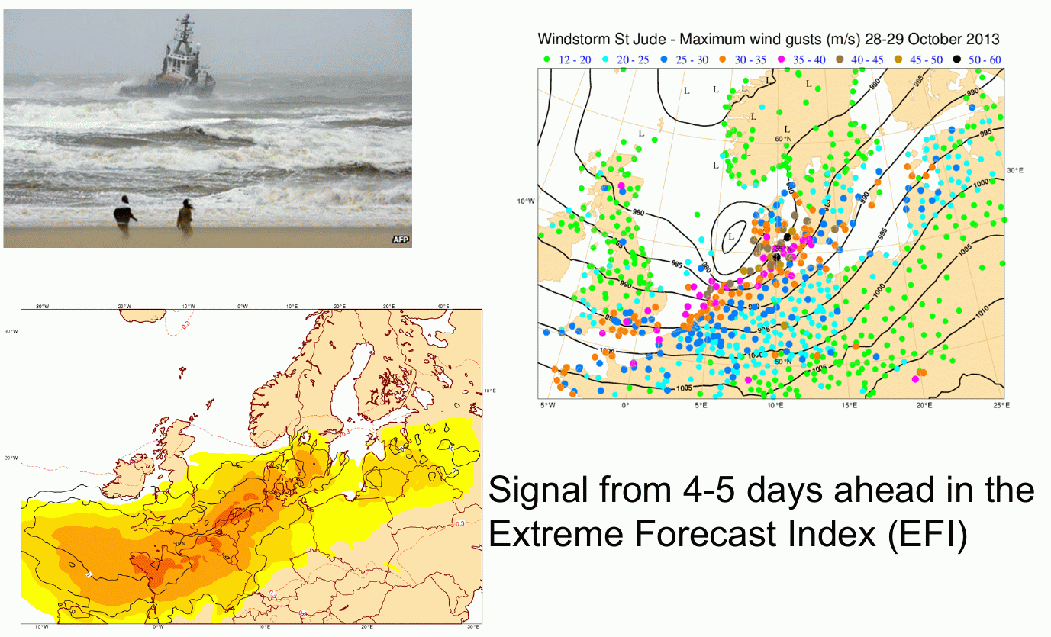
The success story of Numerical Weather Prediction: Wind storms
28-29 October 2013 ‘Christian’ wind gusts
→ 5-day forecast of probabilities for wind gusts exceeding > 10m/s

Slide 10
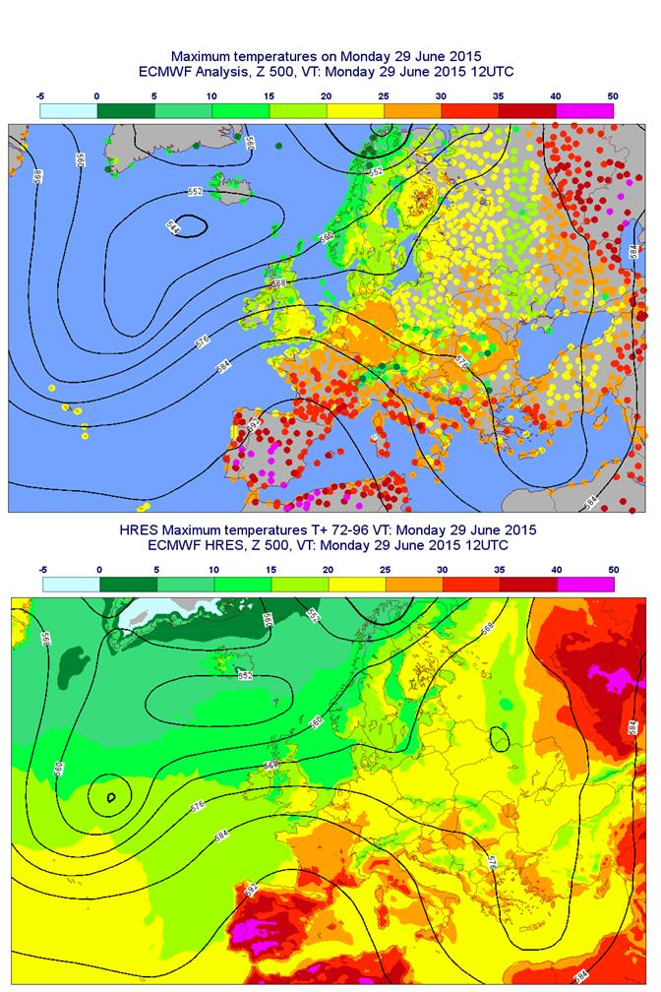
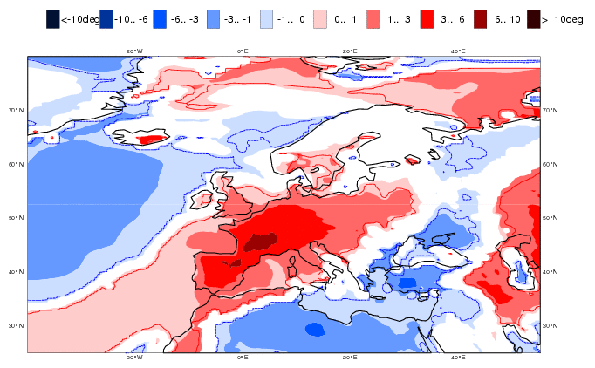
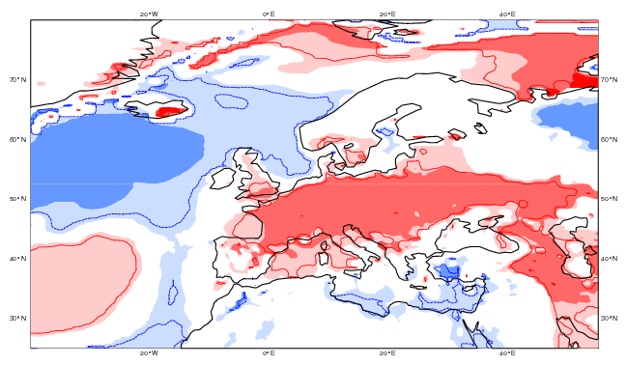
The success story of Numerical Weather Prediction: Heat waves
Maximum observed temperature
Week 2-3½ forecast of probabilities for temperature anomalies exceeding > 5-10K
Temperature anomaly ensemble forecast week-2
Maximum forecast temperature day-3 – day-4
… and week-3½

Slide 11
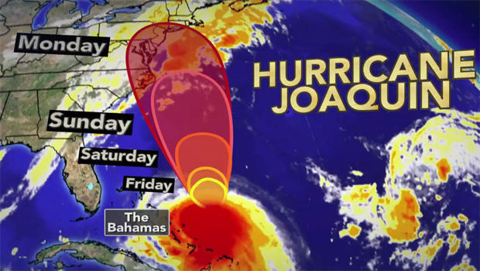
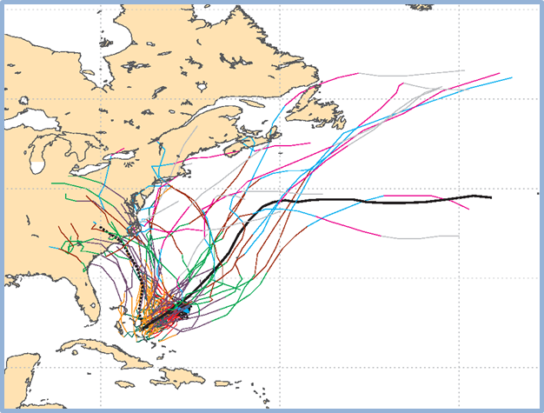
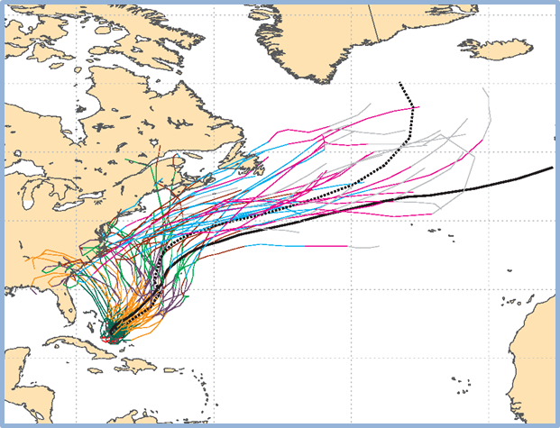
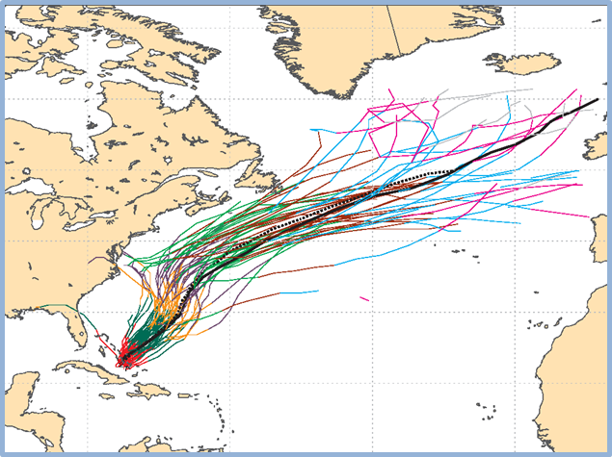
The success story of Numerical Weather Prediction: Hurricanes
29-09-15
30-09-15
01-10-15
Individual trajectories for JOAQUIN during the next 240 hours
tracks: thick solid=HRES; thick dot=CTRL; thin solid=EPS members [coloured]

Slide 12
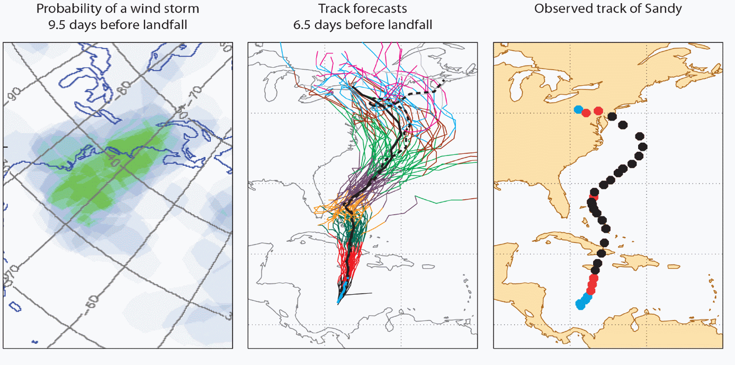
The success story of Numerical Weather Prediction: Hurricanes
→ May be one of the best medium-range forecasts of all times!

Slide 13
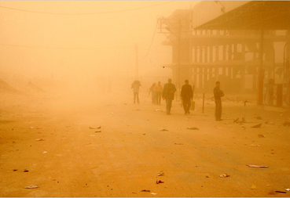
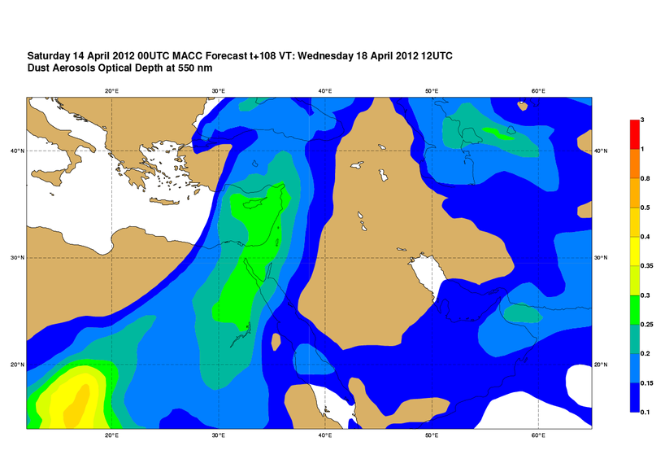
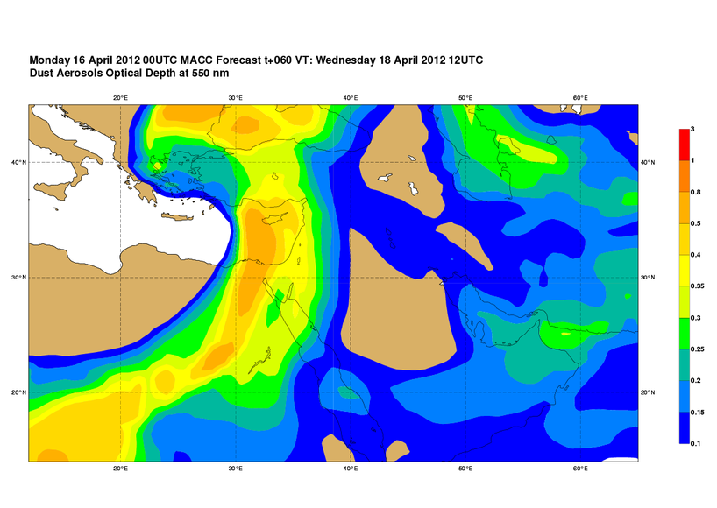
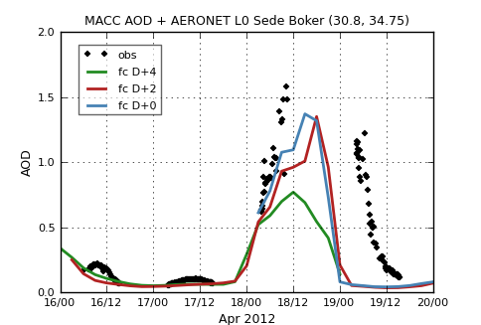
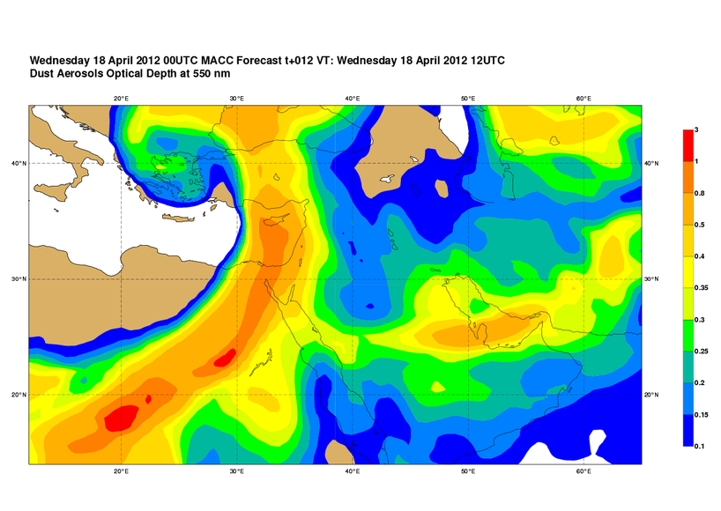
The success story of Numerical Weather Prediction: Dust storms
Day 4
Southern Gaza Strip, on April18, 2012
Day 2
Day 0

Slide 14
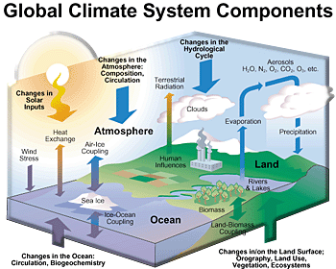



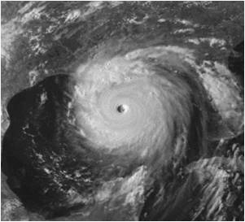

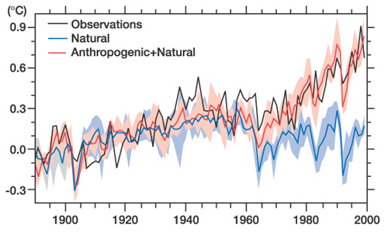
Multiple dimensions
Computer power
Today
Model complexity
Tomorrow
Ensembles
Model resolution
Long climate runs

Slide 15
Strategic target:
Global 5km, seamless analysis-forecast ensemble
in 2025
Four-year plan: Projected HPC cost
2016 2017 2018 2019 2020
Ensemble analaysis: | H resolution o/l | TCo639 |  |  |  |  | TCo1279
 | H resolution i/l | TL191 | TCo191
 | V resolution | L137
 | Coupling |  |  |  | orca025l75
 | Ensemble size | M25 |  | M50
 | Window length | 2x12h | 4x6h
 | Efficiency gains
 | Nodes: | 1600 | 2560 | 5120 | 5632 | 5632 | 28160
 | Factor: | 1 | 1.6 | 2.0 | 1.1 | 1.0 | 5.0
 | Acc. factor: | 1 | 1.6 | 3.2 | 3.5 | 3.5 | 17.6
2016 2017 2018 2019 2020
Ensemble forecast: | H resolution | TCo639 |  |  |  |  | TCo1279
 | V resolution | L91 |  |  | L137
 | Coupling | orca100l42 | orca025l75
 | Forecast range | d10 |  | d15
 | Ensemble size | M51
 | Reforecast ensemble size | M11 |  |  |  | M15
 | Efficiency gains
 | Nodes: | 1530 | 1683 | 2525 | 3787 | 4355 | 21774
 | Factor: | 1 | 1.1 | 1.5 | 1.5 | 1.2 | 5.0
 | Acc. factor: | 1 | 1.1 | 1.7 | 2.5 | 2.8 | 14.2

Slide 16
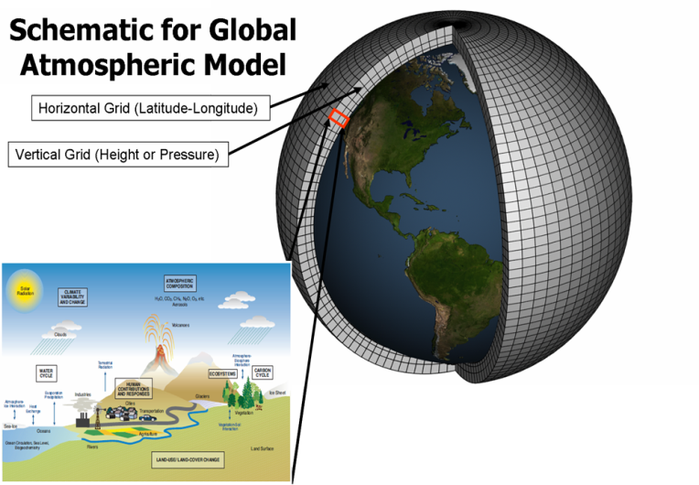
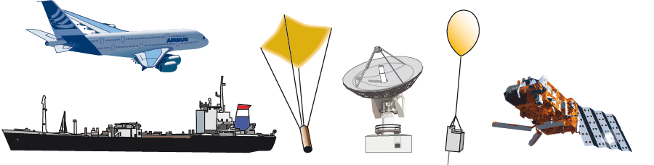
What is the challenge?
 | Observations | Models
Volume | 20 million = 2 x 10⁷ | 5 million grid points 100 levels 10 prognostic variables = 5 x 10⁹
Type | 98% from 60 different satellite instruments | physical parameters of atmosphere, waves, ocean
Today:
 | Observations | Models
Volume | 200 million = 2 x 10⁸ | 500 million grid points 200 levels 100 prognostic variables = 1 x 10¹³
Type | 98% from 80 different satellite instruments | physical and chemical parameters of atmosphere, waves, ocean, ice, vegetation
Tomorrow:
Factor 10 Factor 2000
per day per time step
(10-day forecast today = 1440 time steps)
Notes:
Today: 3 x IR spectrometers with IASI-NG (6 Mb/s) of which 300 channels are used: O(1000)
Tomorrow: 5 x IR spectrometers with IASI-NG: 6 Mb/s of which 500 channels/PCs are used + 5 MTG-IRS (3 Gb/s) of which 500 channels/PCs will be used: O(5000)

Slide 17
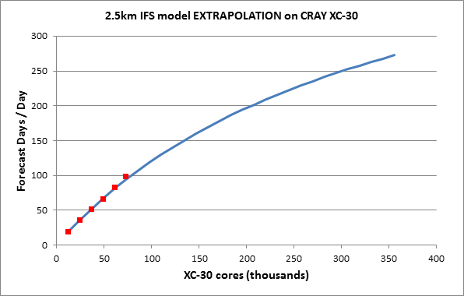
What is the challenge?
Global forecast experiments with ECMWF’s IFS at 2.5 km (today’s resolution is 9 km) – still far away from targeted 1 km resolution
Operational target:
10-day forecast in 1 hour
= 240 forecast days / day
Extrapolation to
bigger computers
Real runs on
available
Cray XC-30
2 MW 6 MW + research + other services = 60 MW?
Operational target requires ~270,000 cores

Slide 18
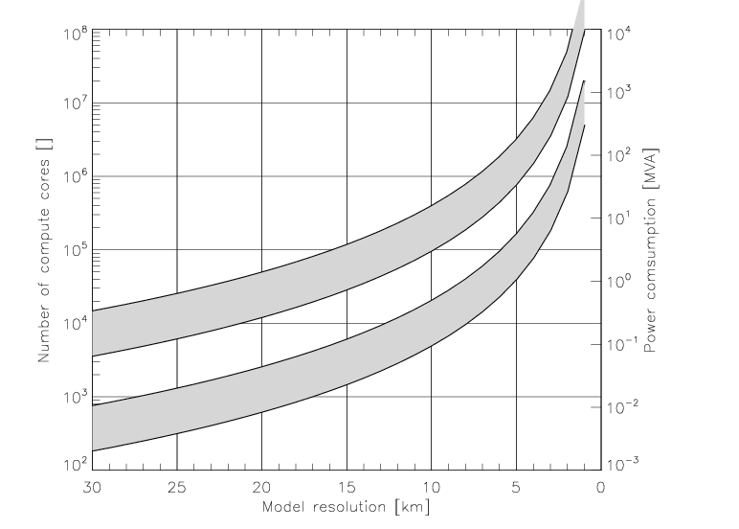

Simple compute projection (only resolution)
Ensemble
Single
Power limit
scalability range
≈ M€ electricity/year
scalability range
2016
2025
[Bauer et al. 2015]

Slide 19
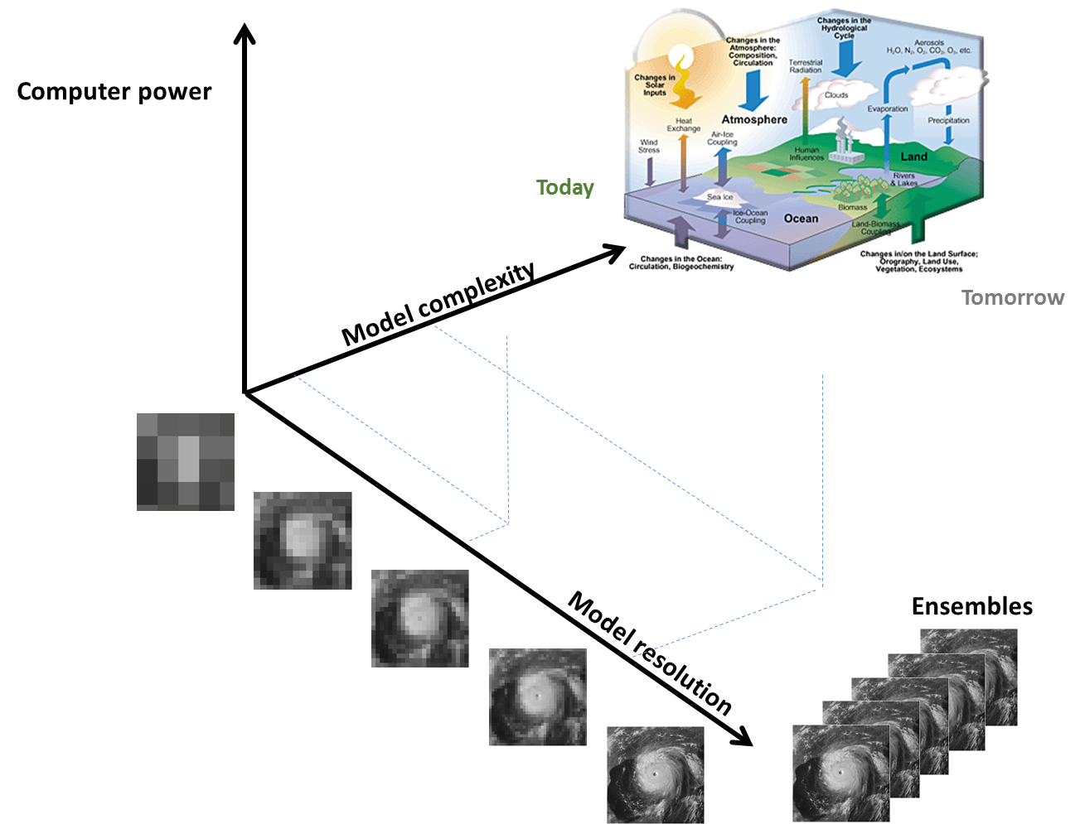
Data projection
time
2015
Time critical
21 TB/day written
22 million fields
85 million products
11 TB/day sent to customers
Non-time critical
100 TB/day archived
400 research experiments
400,000 jobs / day
2020 2025?
Time critical
128 TB/day written
90 million fields
450 million products
60 TB/day sent to customers
Non-time critical
1 PB/day archived
1,000 research experiments
1,000,000 jobs / day
[Courtesy Tiago Quintino]
→ Factor 5-10 every 5 years!

Slide 20

Required: Billion-way parallelism
Hardware
hybrid computing model seems to be here to stay;
memory systems will become ever more complicated;
hardware faults require fast adaptation strategies.
Interconnection technology is seriously lagging behind computing power: 2-3 orders of magnitude gap!
Software
message-driven execution models;
large-scale data analytics at the intersection of numerical linear algebra and data analytics;
broad spectrum of programming languages;
auto-tuning.
  [Dongarra et al. 2015]
“We believe that the time has come for the leaders of the computational science movement to focus their energies on creating software research centers to make progress on both hardware and software fronts simultaneously with a level of sustained, interdisciplinary collaboration among the core research communities.”

Slide 21
Decisions made in the past: Spectral model
Horizontal discretization of a variable, e.g. temperature:
Triangular truncation
(isotropic)
Spherical harmonics
Fourier functions
associated Legendre polynomials
Legendre transform
by Gaussian quadrature
using N_{L} ≥ (2N+1)/2
“Gaussian” latitudes (linear grid)
((3N+1)/2 if quadratic grid)
“fast” algorithm desirable …
FFT (fast Fourier transform)
using
N_{F} ≥ 2N+1
points (linear grid)
(3N+1 if quadratic grid)
“fast” algorithm available …
Triangular truncation:
n
N
[Courtesy Nils Wedi]
m = -N
m = N
m

Slide 22
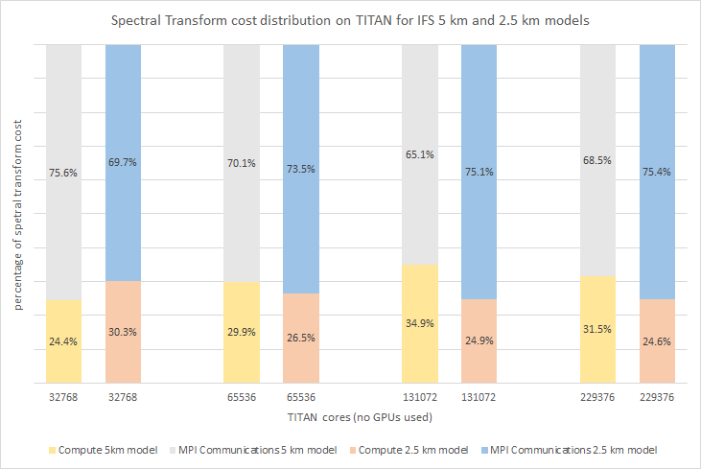
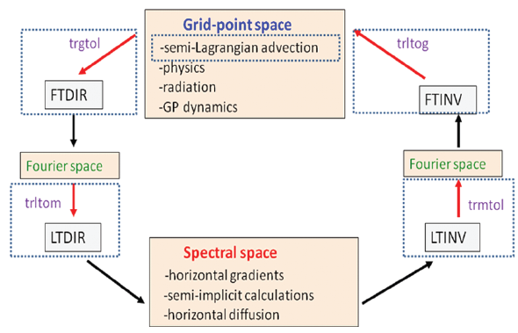
Decisions made in the past: Spectral model
Communication vs computation cost:
Once per time step:
→ Spectral transforms ~ 30% of total model cost (physics + waves 40%, SL-scheme 10% etc.) at globally 9 km resolution
[Courtesy George Mozdzynski]

Slide 23
Decisions made in the past: Spectral model
Use of fast Legendre transform:
Nils P. Wedi, Mats Hamrud, and George Mozdzynski, 2013: A Fast Spherical Harmonics Transform for Global NWP and Climate Models. Mon. Wea. Rev., 141, 3450–3461.
Transforms on GPUs:
[Courtesy George Mozdzynski]

Slide 24
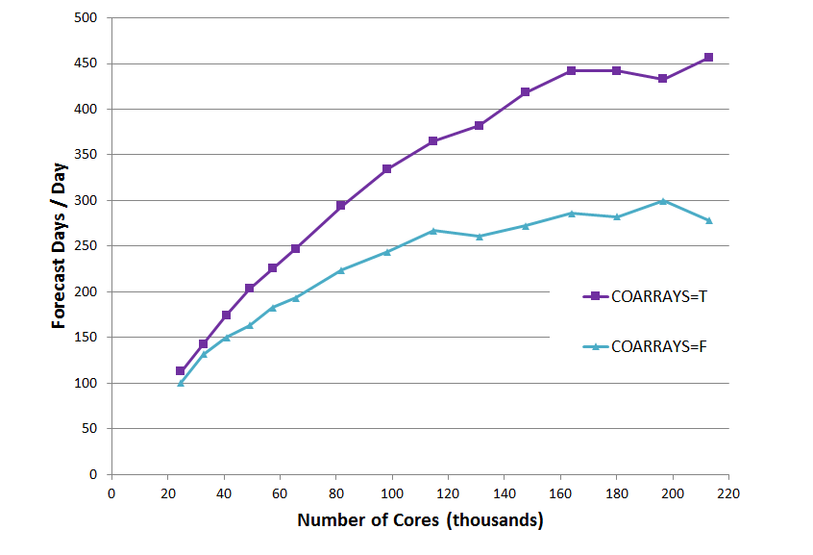
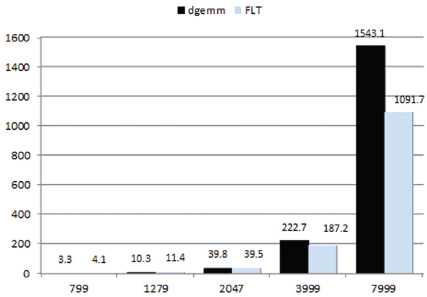
Decisions made in the past: Spectral model
Overlap of communication and computation:
Mozdzynski et al. 2015: A PGAS implementation of the ECMWF IFS. Int. J. High-Perf. Comp. App.
Before After
msec./transform
Not supported by all compilers!
[Courtesy George Mozdzynski]

Slide 25


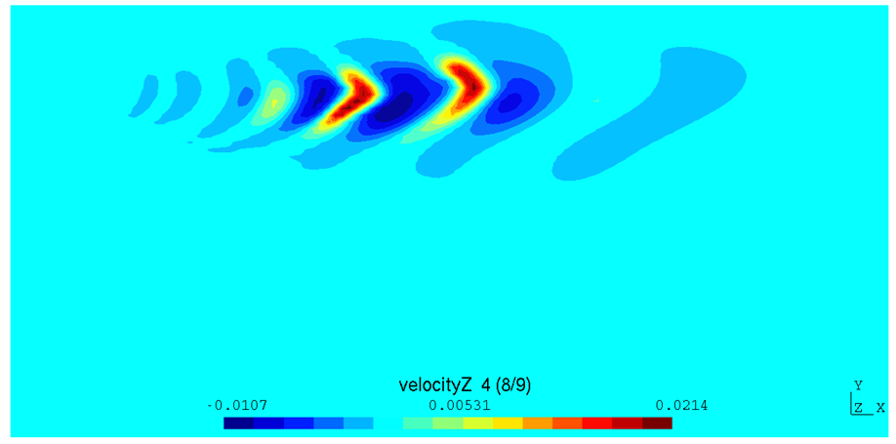
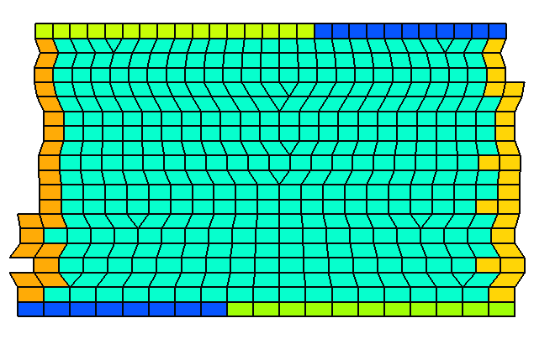
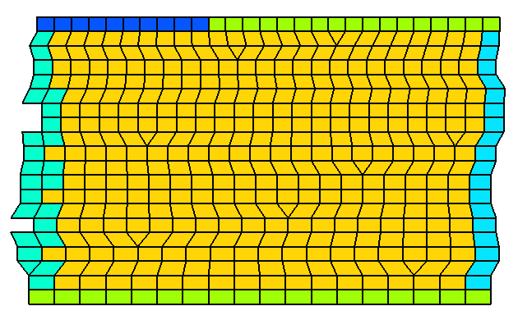
Decisions made in the past: Spectral model
New data structures
Unstructured mesh / structured grid support
Compact stencil space discretisation
Nearest neighbour communication
… multiple grids, I/O, spectral transforms
Model dynamical core
Fully compressible equations (non-hydrostatic)
Conservative, monotone transport
Finite volume model
… hybridization with spectral model

Slide 26
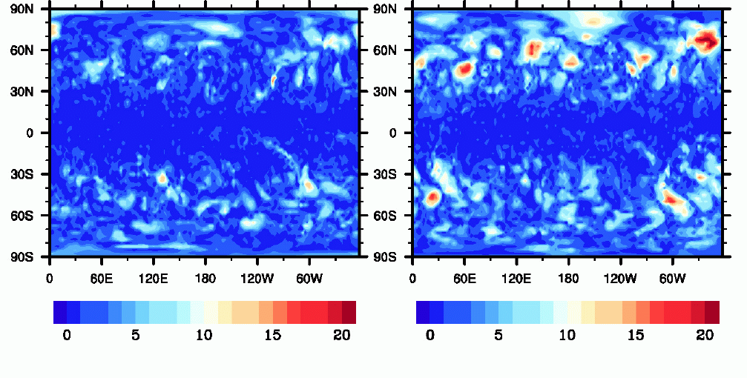
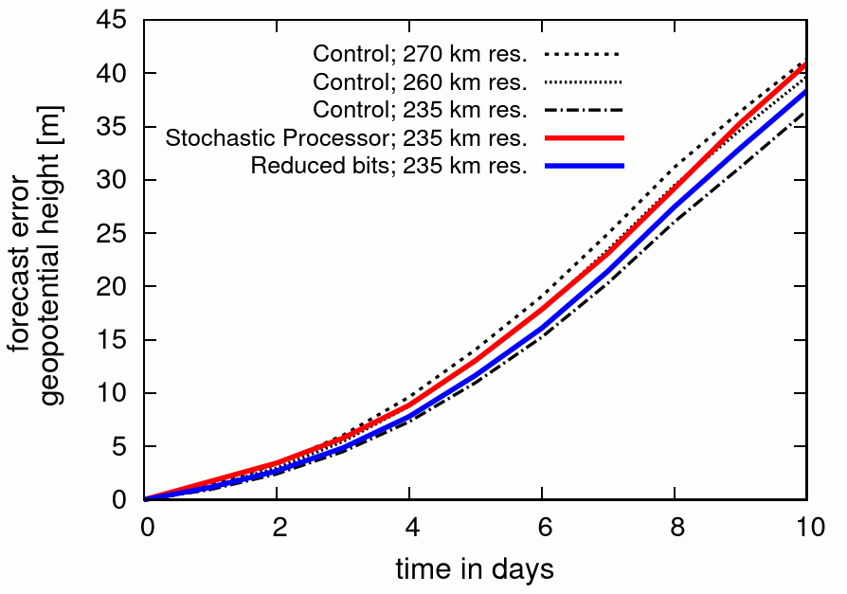
Decisions made in the past: Double precision
Ensemble experiments with the ECMWF IFS using single precision arithmetics throughout:
→ saves 25-30% of runtime! Day-10 forecast difference Day-10 ensemble spread
SP vs DP (T in K at 850 hPa) all DP (T in K at 850 hPa)
← Single forecast runs with Reading IGCM testing
random errors of significand and 6-8 bit representation
(Düben et al. 2013, 2014)

Slide 27
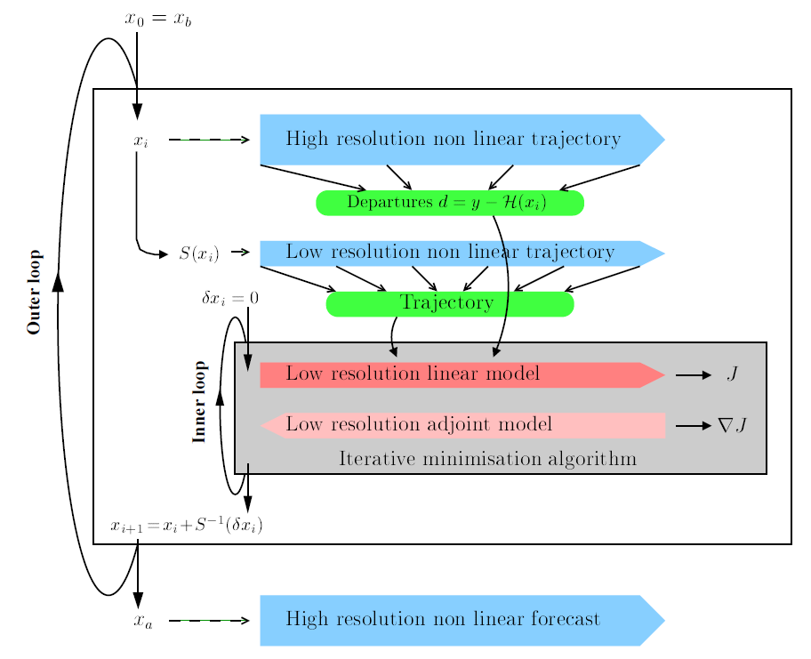
Decisions made in the past: 4D-Var
Four-dimensional variational assimilation (4D-Var) method was introduced in 1997 and has given ECMWF an enormous boost in skill:
Combines observations with model calculations over time window
Produces solution to best fit short-range forecast and observations within their error margins - consistent in space and time!
But:
Uses 3 outer loop model integrations (iterations)
Between 30-70 inner loop iterations
Needs tangent-linear and adjoint models
… and is therefore fundamentally sequential and thus slow (single + ensemble analysis cost ~50% of entire forecast suite!)
(Trémolet 2003)

Slide 28
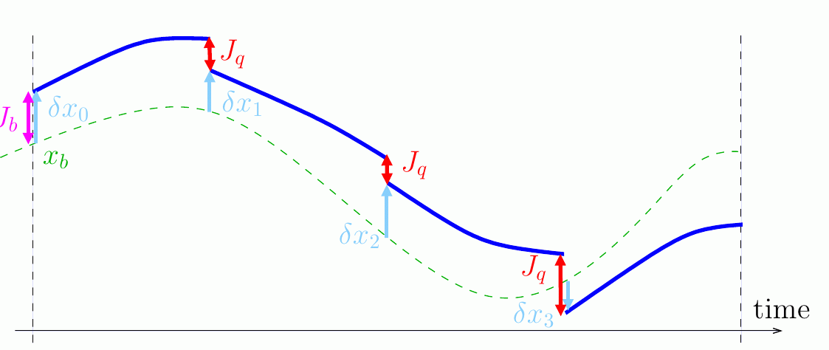
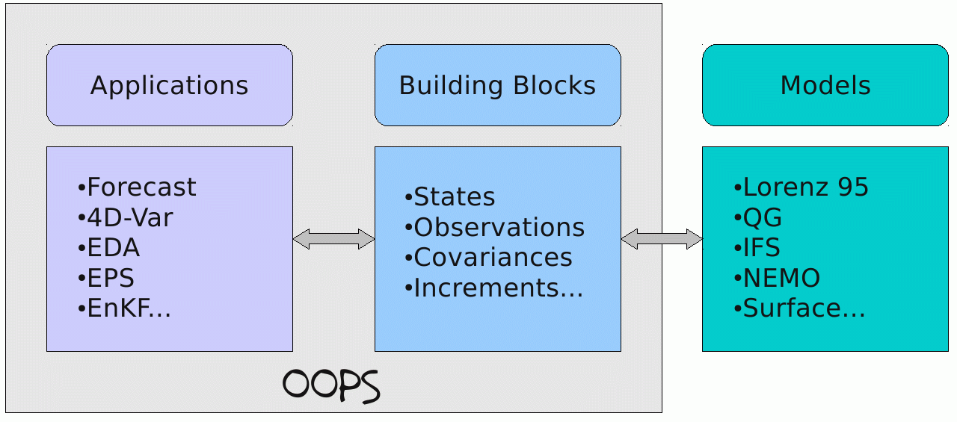
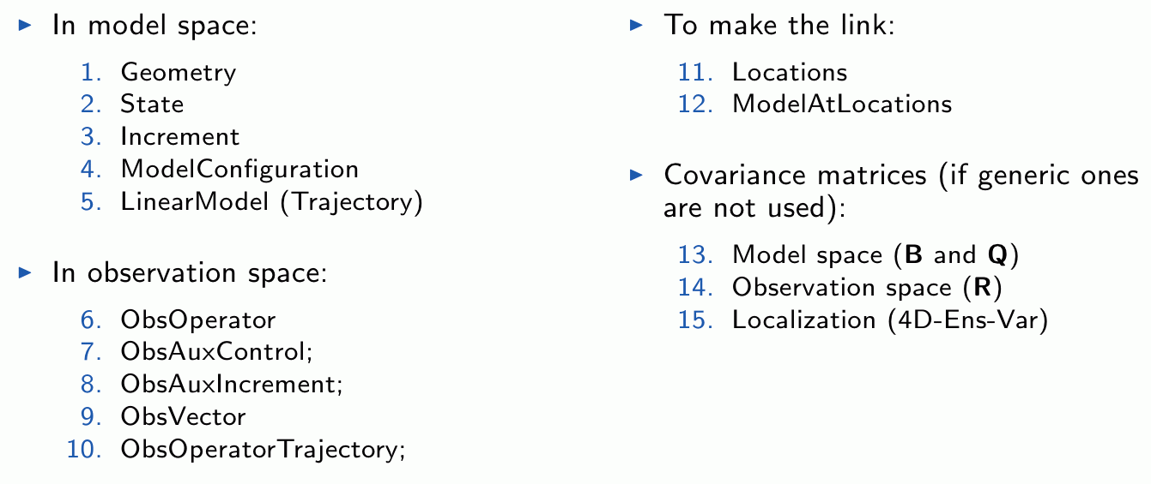
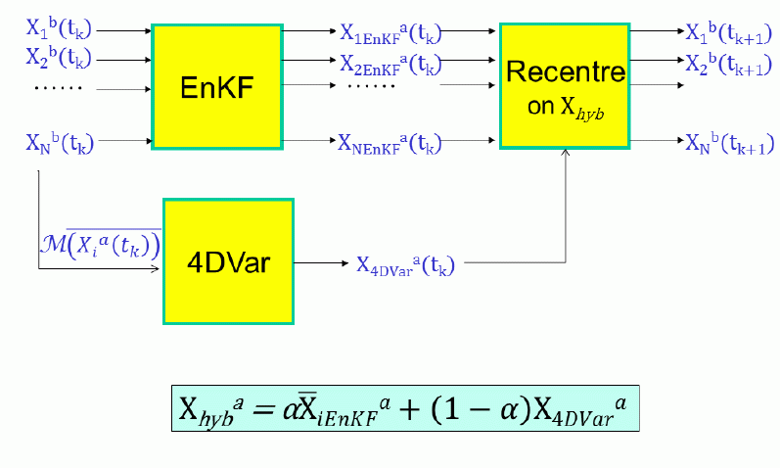
Decisions made in the past: 4D-Var
Object Oriented Prediction System (OOPS):
Object-oriented design and call structure
Top-level control level with abstract building blocks
Classes can be flexibly assembled
Future data assimilation system configurations:
Model error formulation
Saddle-point algorithm
Hybrid ensemble – variational formulation
Coupling with ocean, sea-ice, land

Slide 29
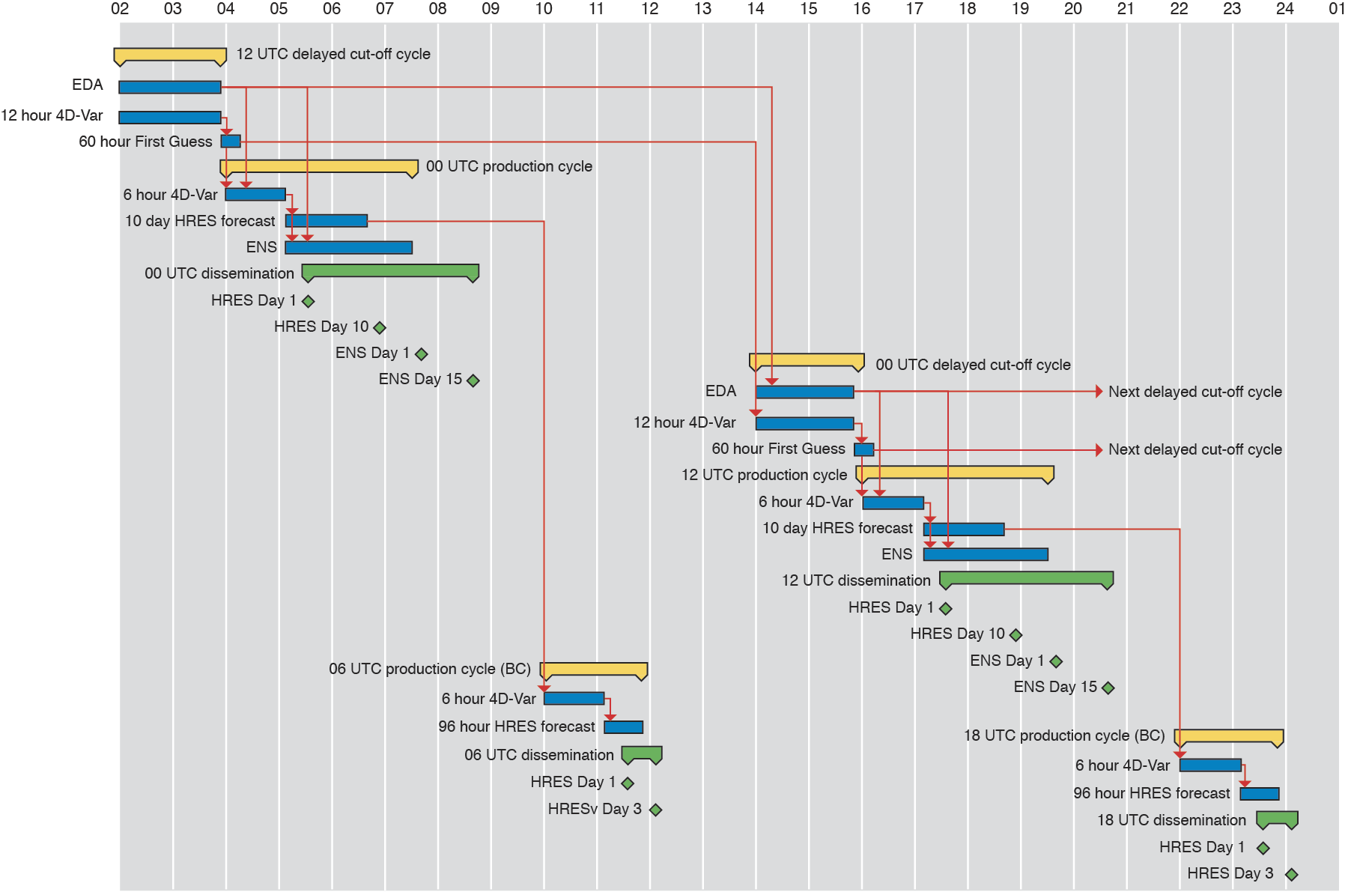
Decisions made in the past: Heritage (community) code
Daily critical path work flow
Heritage code:
2,500,000 lines of Fortran code
200,000 lines of scripts
Community code:
Code base shared with Météo-France and European regional consortia
Key requirements:
fundamental refactoring,
incremental optimization,
scientific flexibility,
readability for scientists, platform ‘independence’
at the same time!

Slide 30
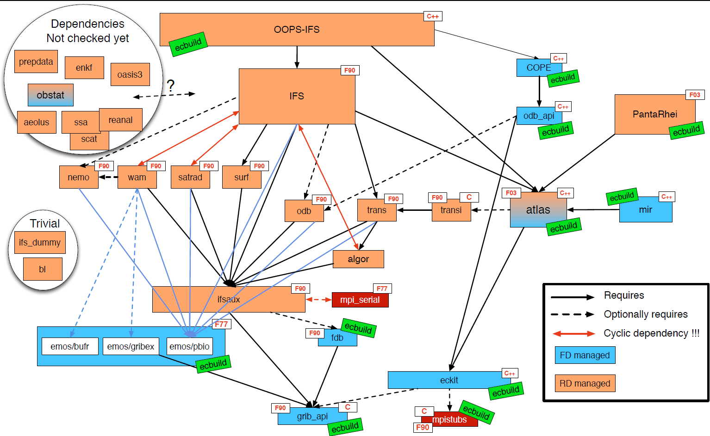
Decisions made in the past: Software dependencies
[Courtesy Willem Deconinck]

Slide 31
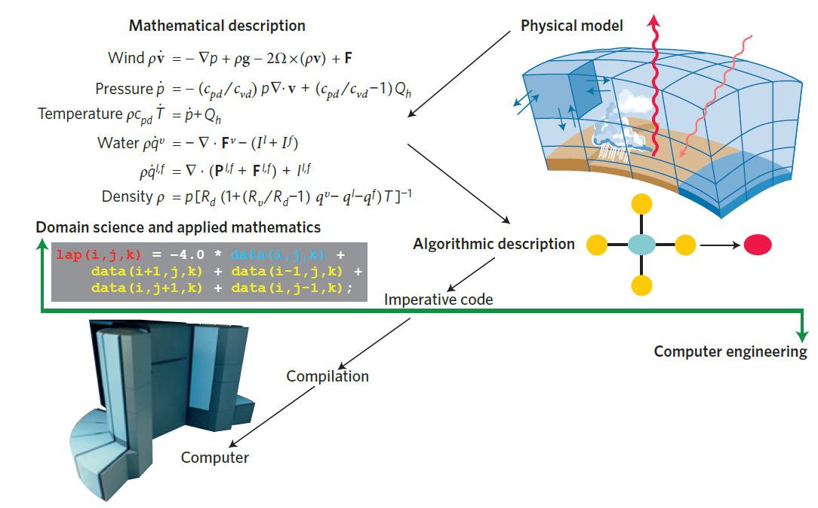
Traditional science workflow
  [Schulthess 2015]

Slide 32
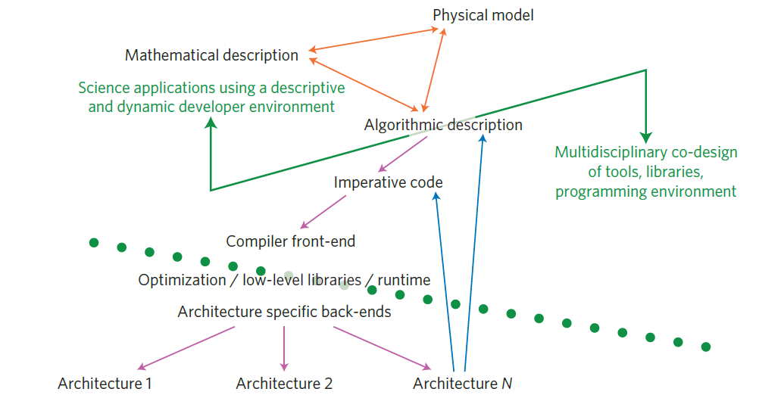


Future science workflow
Energy efficient SCalable Algorithms for weather Prediction at Exascale
→ www.hpc-escape.eu
↑ science specific code
↓ generic code
  [Schulthess 2015]

Slide 33
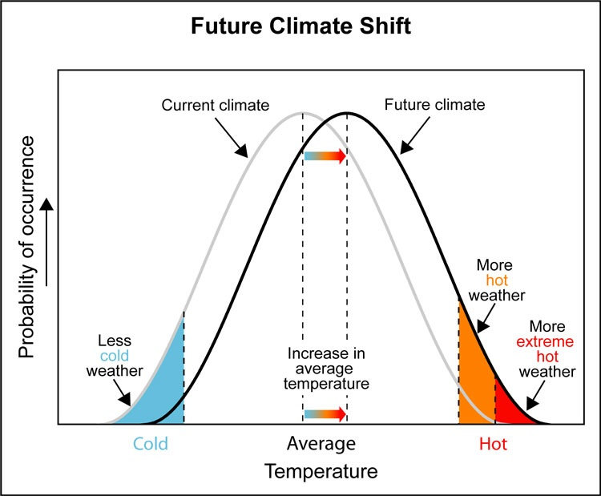
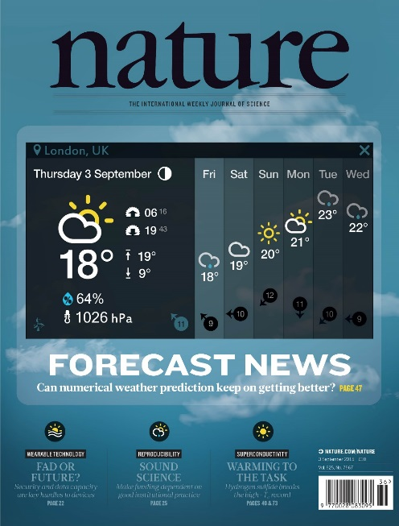
The future of Numerical Weather Prediction
‘The quiet revolution of numerical weather prediction’
by P. Bauer, A.J. Thorpe, G. Brunet
in Nature, 3 September 2015:
[IPCC]

Slide 34
SOS questions for NWP
Are we entering a new age of software development for HPC?
Clearly yes, with multi-disciplinary co-design including
numerical methods and kernels adapted to range of architectures
Application software longevity - a blessing or a curse?
Both, there is no other way as science codes are not plug-and-play, and evolve slowly!
But co-design approach will introduce more flexibility for both math. solutions and hardware
What evolving applications and workflows are driving HPC today?
Not sure about weather & climate, but if addressed together there may be leverage
Is co-design having an impact on system design?
May be, and it is very high on the wish list of the European Commission (EsD’s in 2018)
How have HPC operating systems and runtime environments evolved?
[Schulthess 2015]

Slide 35



Energy efficient SCalable Algorithms for weather Prediction at Exascale: ESCAPE
[www.hpc-escape.eu]

Slide 36



Centre of Excellence in Simulation of Weather and Climate in Europe: ESiWACE
[www.esiwace.eu]

