Slide 1
D-Wave Update SOS20 Conference
René Copeland (rcopeland@dwavesys.com)
Director of Government Sales
March 23, 2016

Slide 2
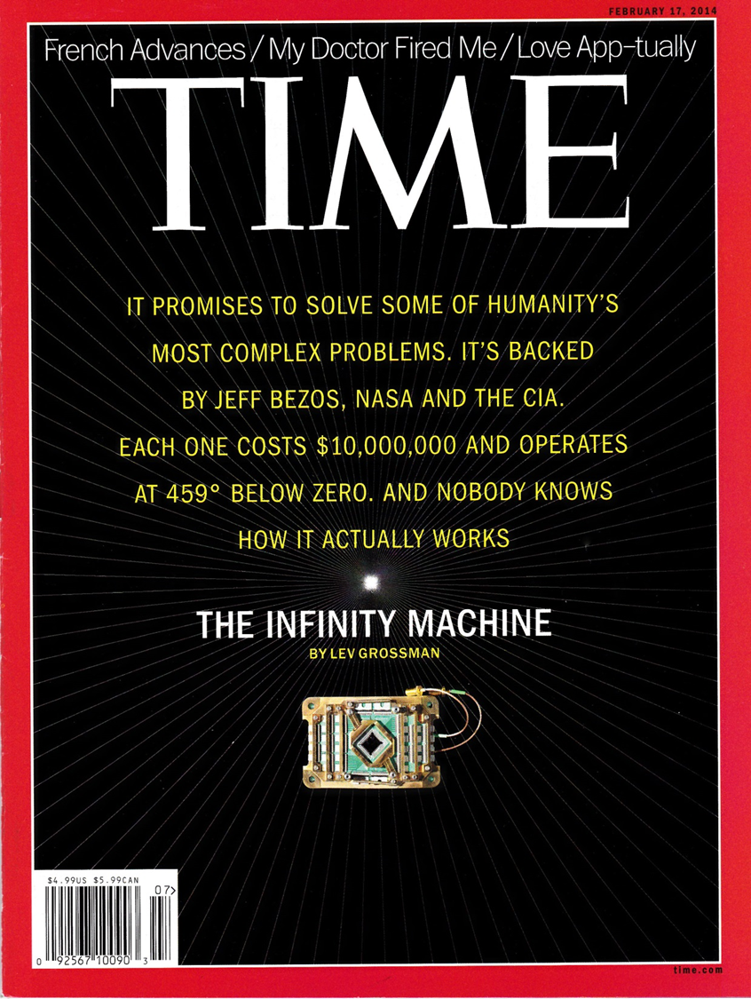

Slide 3
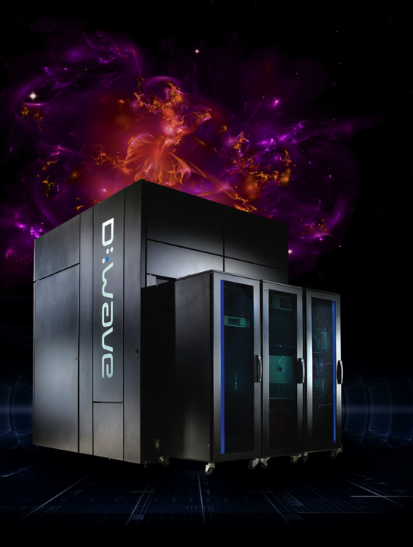
The D-Wave 2X
Founded in 1999
Headquartered in Vancouver, BC
150 people
Three US subsidiaries
European/Asian presence
World’s first commercial quantum computer
Two 1,000 qubit systems installed; one on order
Lockheed/USC
Google/NASA Ames/USRA
Los Alamos National Lab
110 U.S. patents
$174M (CAD) in equity funding raised
70 Peer Reviewed Publications

Slide 4
D-Wave Investors
International Investment
and Underwriting

Slide 5
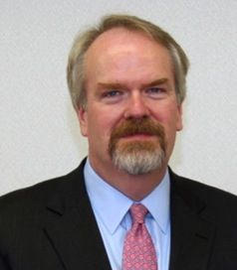
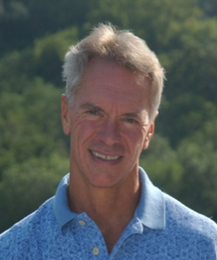
D-Wave Executive Team
Vern Brownell, CEO CEO Egenera, CTO Goldman Sachs | Dr. Geordie Rose, CTO Founder, D-Wave |  | Bo Ewald, COO Int’l Ops CEO, Cray, SGI

Slide 6
The D-Wave 2X

Slide 7
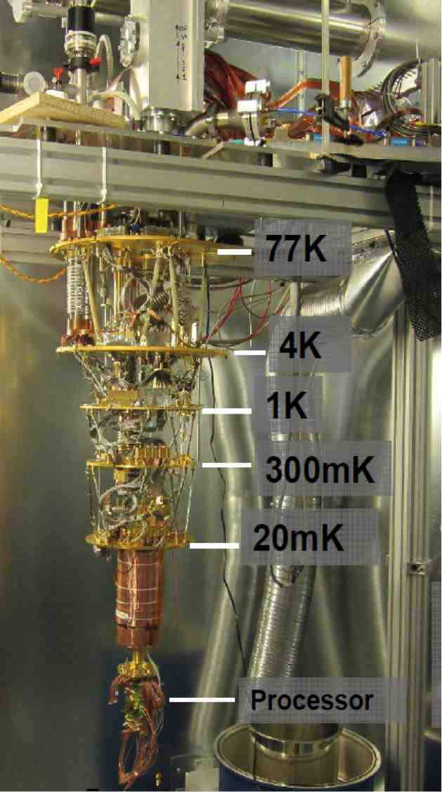
Processor Environment
Cooled to 0.012 degrees Kelvin, 150x colder than interstellar space
Shielded to 50,000× less than Earth’s magnetic field
In a high vacuum: pressure is 10 billion times lower than atmospheric pressure
On low-vibration floor
<25 kW total power consumption – for the next few generations

Slide 8
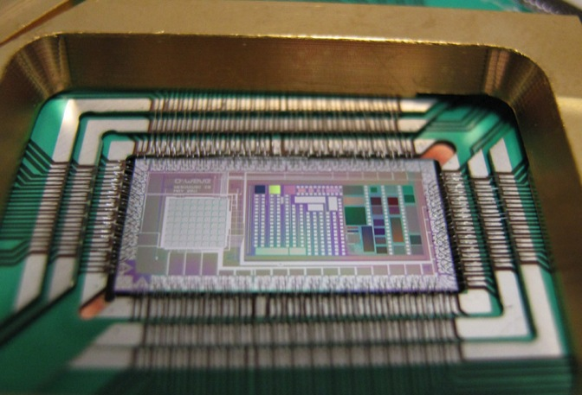
D-Wave Two Quantum Processor
Qubits within red boxes

Slide 9
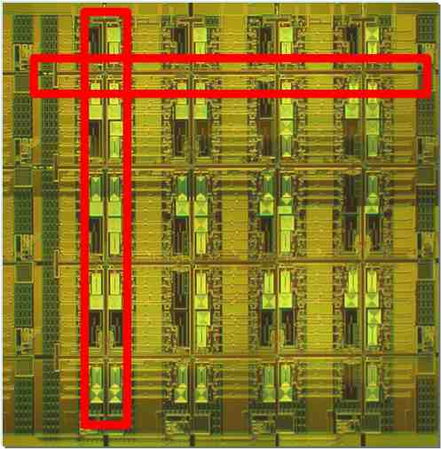
Processing Using D-Wave
Made from a lattice of superconducting circuits (qubits)
Cooled close to absolute zero to enable quantum effects
User maps a problem into a search for lowest points in a vast landscape, which correspond to the best possible outcomes
Processor considers all possibilities simultaneously to determine the lowest energy required to form the specified relationships
Those states, seen as the optimal outcomes, are the answers
Qubits within red boxes
Notes:
- This is not a Turing machine

Slide 10
1152 Qubit Chip

Slide 11
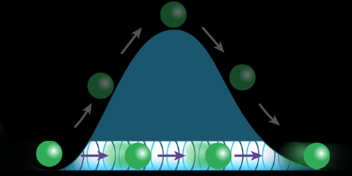
Quantum Effects on D-Wave Systems
Superposition
Entanglement
Quantum Tunneling
Notes:
superposition: the ability of a qubit to hold both of the values 0 and 1 (alternately, -1/1) at the same time
collapses to single value when read out
an N-qb value can hold all 2^N distinct values simultaneously; i.e., the computational power grows as 2^N
entanglement: the ability of two non-adjacent objects to maintain the same state
in mapping a problem to hardware, means that two qbs can remain in the same state even though physically separate; as one’s value changes, the other’s will too, without external stimulus
quantum tunneling: i.e., while searching for the lowest point in a landscape, the ability to “tunnel” from one local minimum to another local minimum, avoiding the intervening “higher ground”

Slide 12
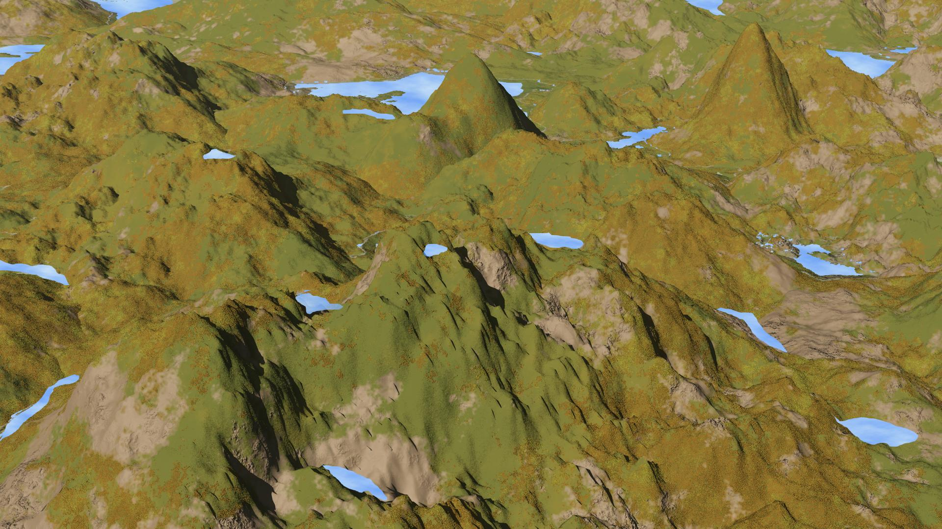
How it Works

Slide 13
How Does A D-wave Computer Work
User Maps a problem to search for “lowest point in a vast landscape”
System processes an enormous search space ( ex 2^1000 ~=10^300) with one instruction
Processor considers all possibilities simultaneously, finds the lowest energy solutions
Multiple solutions returned to the user, sorted by optimal probability

Slide 14
Mission
To help solve the most challenging problems in the multiverse:
Optimization
Machine Learning
Monte Carlo/Sampling

Slide 15
Machine Learning: Binary Classification
Traditional algorithm recognized car about 84% of the time
Google/D-Wave Qboost algorithm implemented to recognize a car (cars have big shadows!)
“Quantum Classifier” was more accurate (94%) and more efficient
Ported quantum classifier back to traditional computer, more accurate and fewer CPU cycles (less power)!

Slide 16
Discrete Combinatorial Optimization Benchmarks Median Time to Find Best Solution
Timing Benchmark – Smaller is Better
D-WAVE II
The D-Wave Two won’t solve all problems, but for some important problems it does very well
Notes:
- note that DW advantage should grow as 2^#qb as #qbs grows

Slide 17
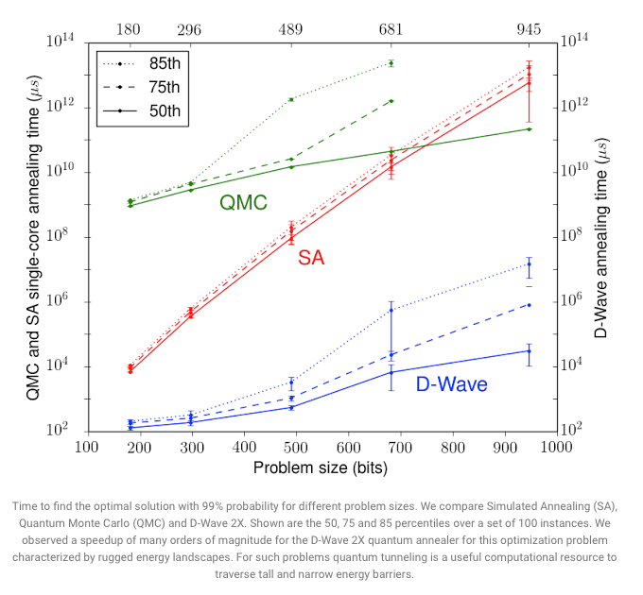
Google Results
http://googleresearch.blogspot.ca/2015/12/when-can-quantum-annealing-win.html

Slide 18
Roughly 1955 in Classical Computer Time

Slide 19
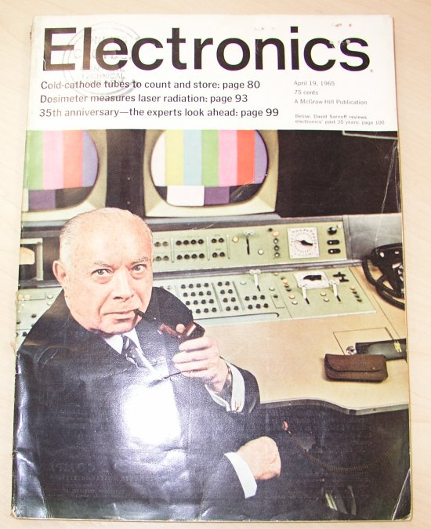
Electronics April 19, 1965

Slide 20
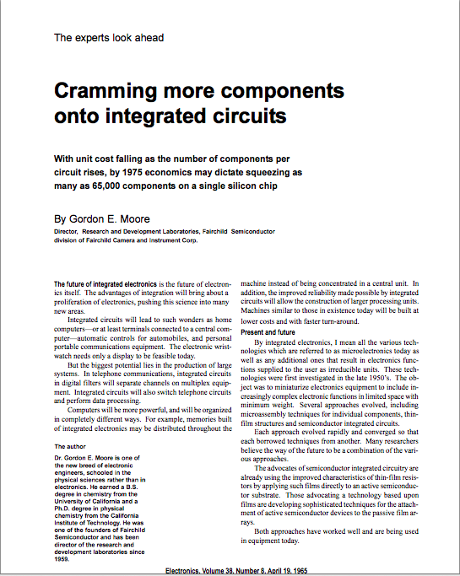
Moore’s Law

Slide 21
The Moore’s Law Law
There’s a law about Moore’s Law
“The number of people predicting the death of Moore’s Law doubles every two years.”
Peter Lee, a vice-president at Microsoft Research

Slide 22
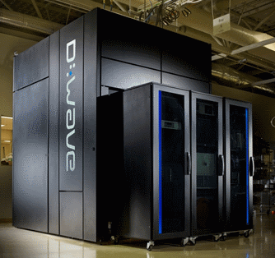
D-Wave Technical Progress
10,000
1,000
100
10
1
2,000
qubit
D-Wave One
128 qubit
1000 qubit
Number of Qubits
28 qubit
16 qubit
4 qubit
D-Wave Two
512 qubit
2002
2006
2010
2014

Slide 23
René Copeland (rcopeland@dwavesys.com)

